Slide 1
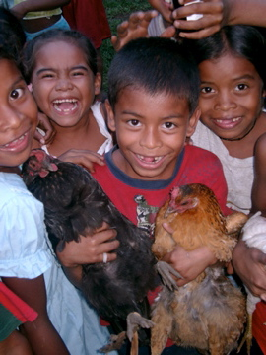
Save
Their
Smiles!
A dental health outreach by Partners in Health.

Slide 2
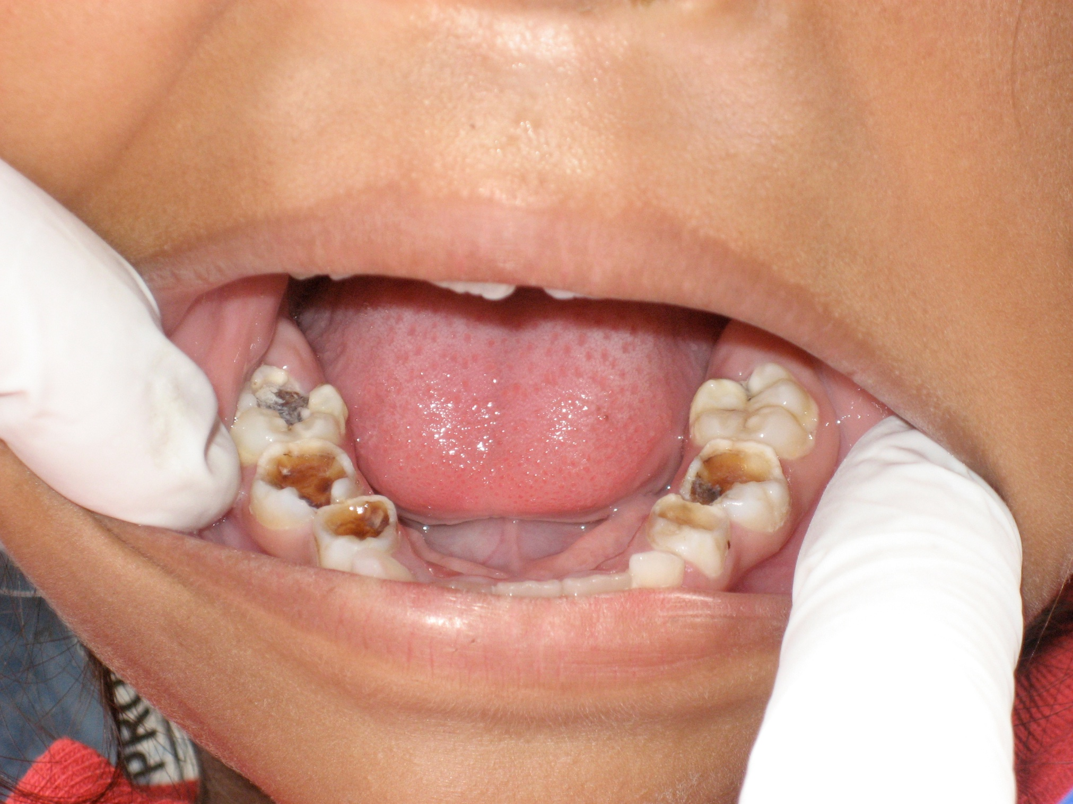
Bad Teeth

Slide 3
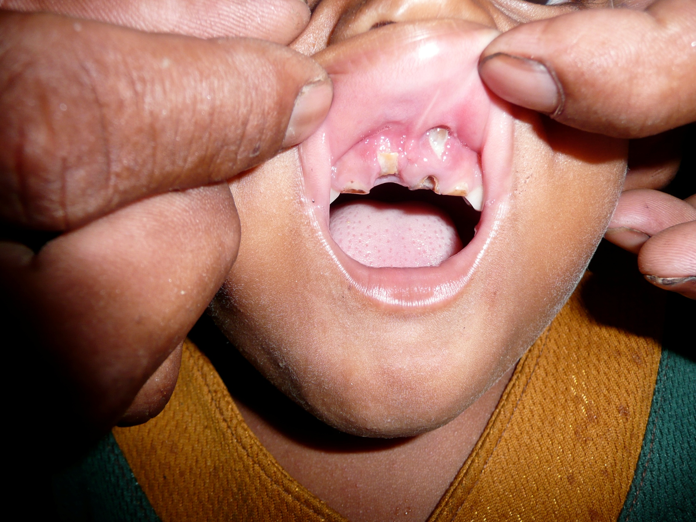
WORSE TEETH! Ouch ! ! !

Slide 4
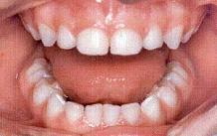
Healthy teeth – white and shiny.
Notes:
Son blancos, sin oyos o partes negros. Las encias son rosa y sanos, sin inflamación rojo

Slide 5
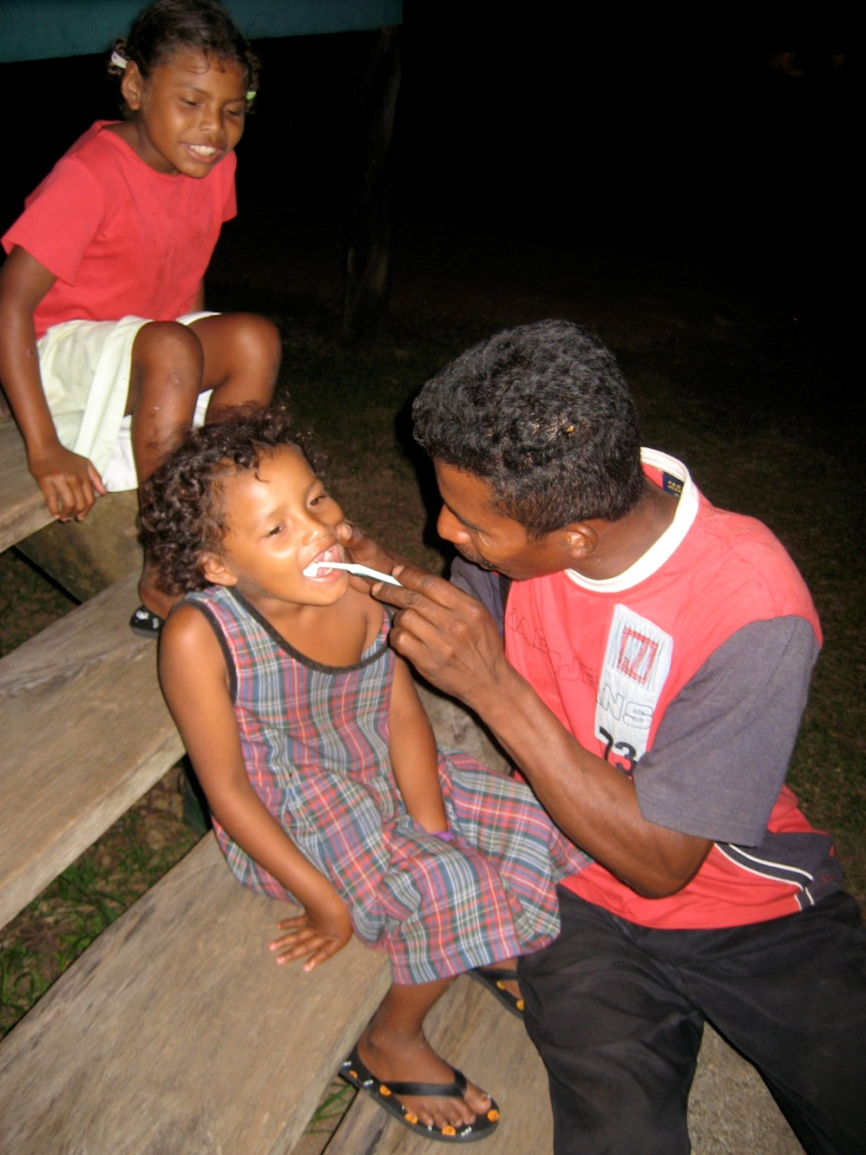
Save their Smiles! How?
Education
Education
Education
And
BRUSH, BRUSH, BRUSH ! ! !

Slide 6

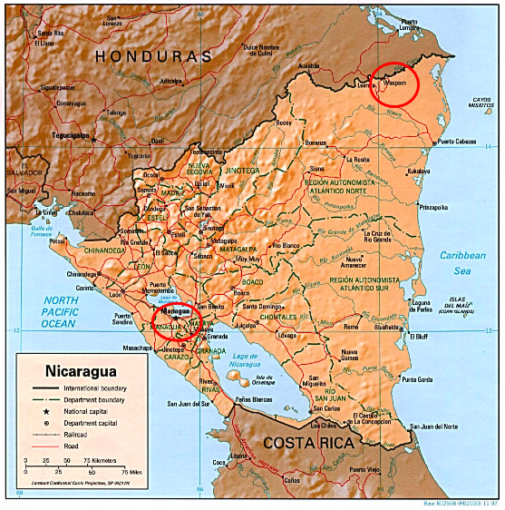
December 2010:
Bilwaskarma, Nicaragua
Atlantic Coast = Miskito/Creole

Slide 7
What is it like to live there?

Slide 8
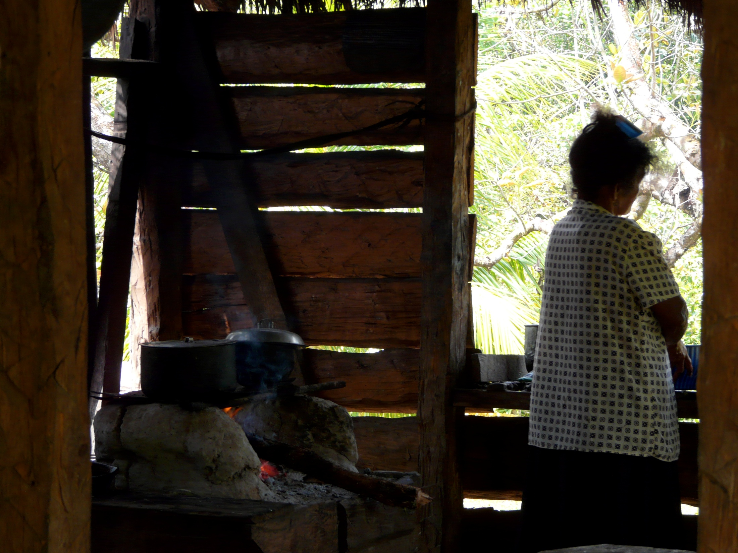
A Kitchen - the stove is made of clay.
There is no electricity or running water.

Slide 9
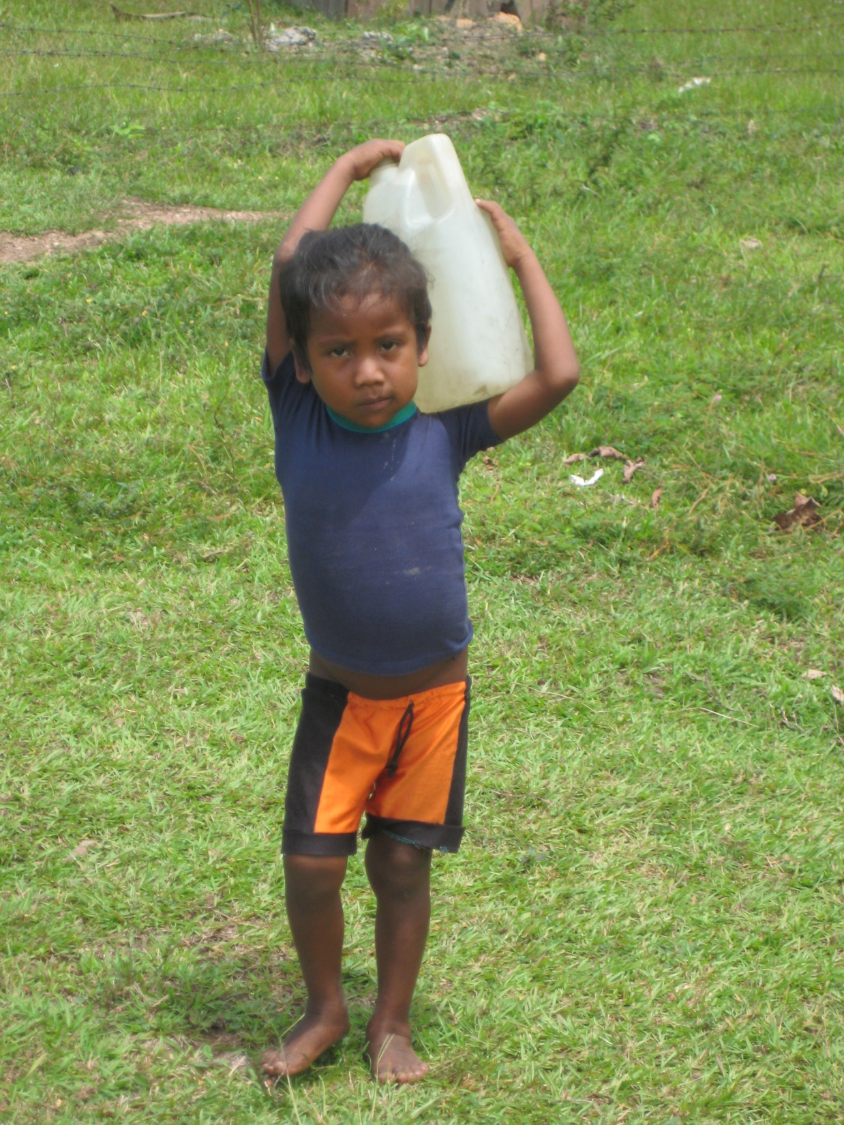
Fetching water
Kids have to help out a lot, even at 4 years of age.

Slide 10
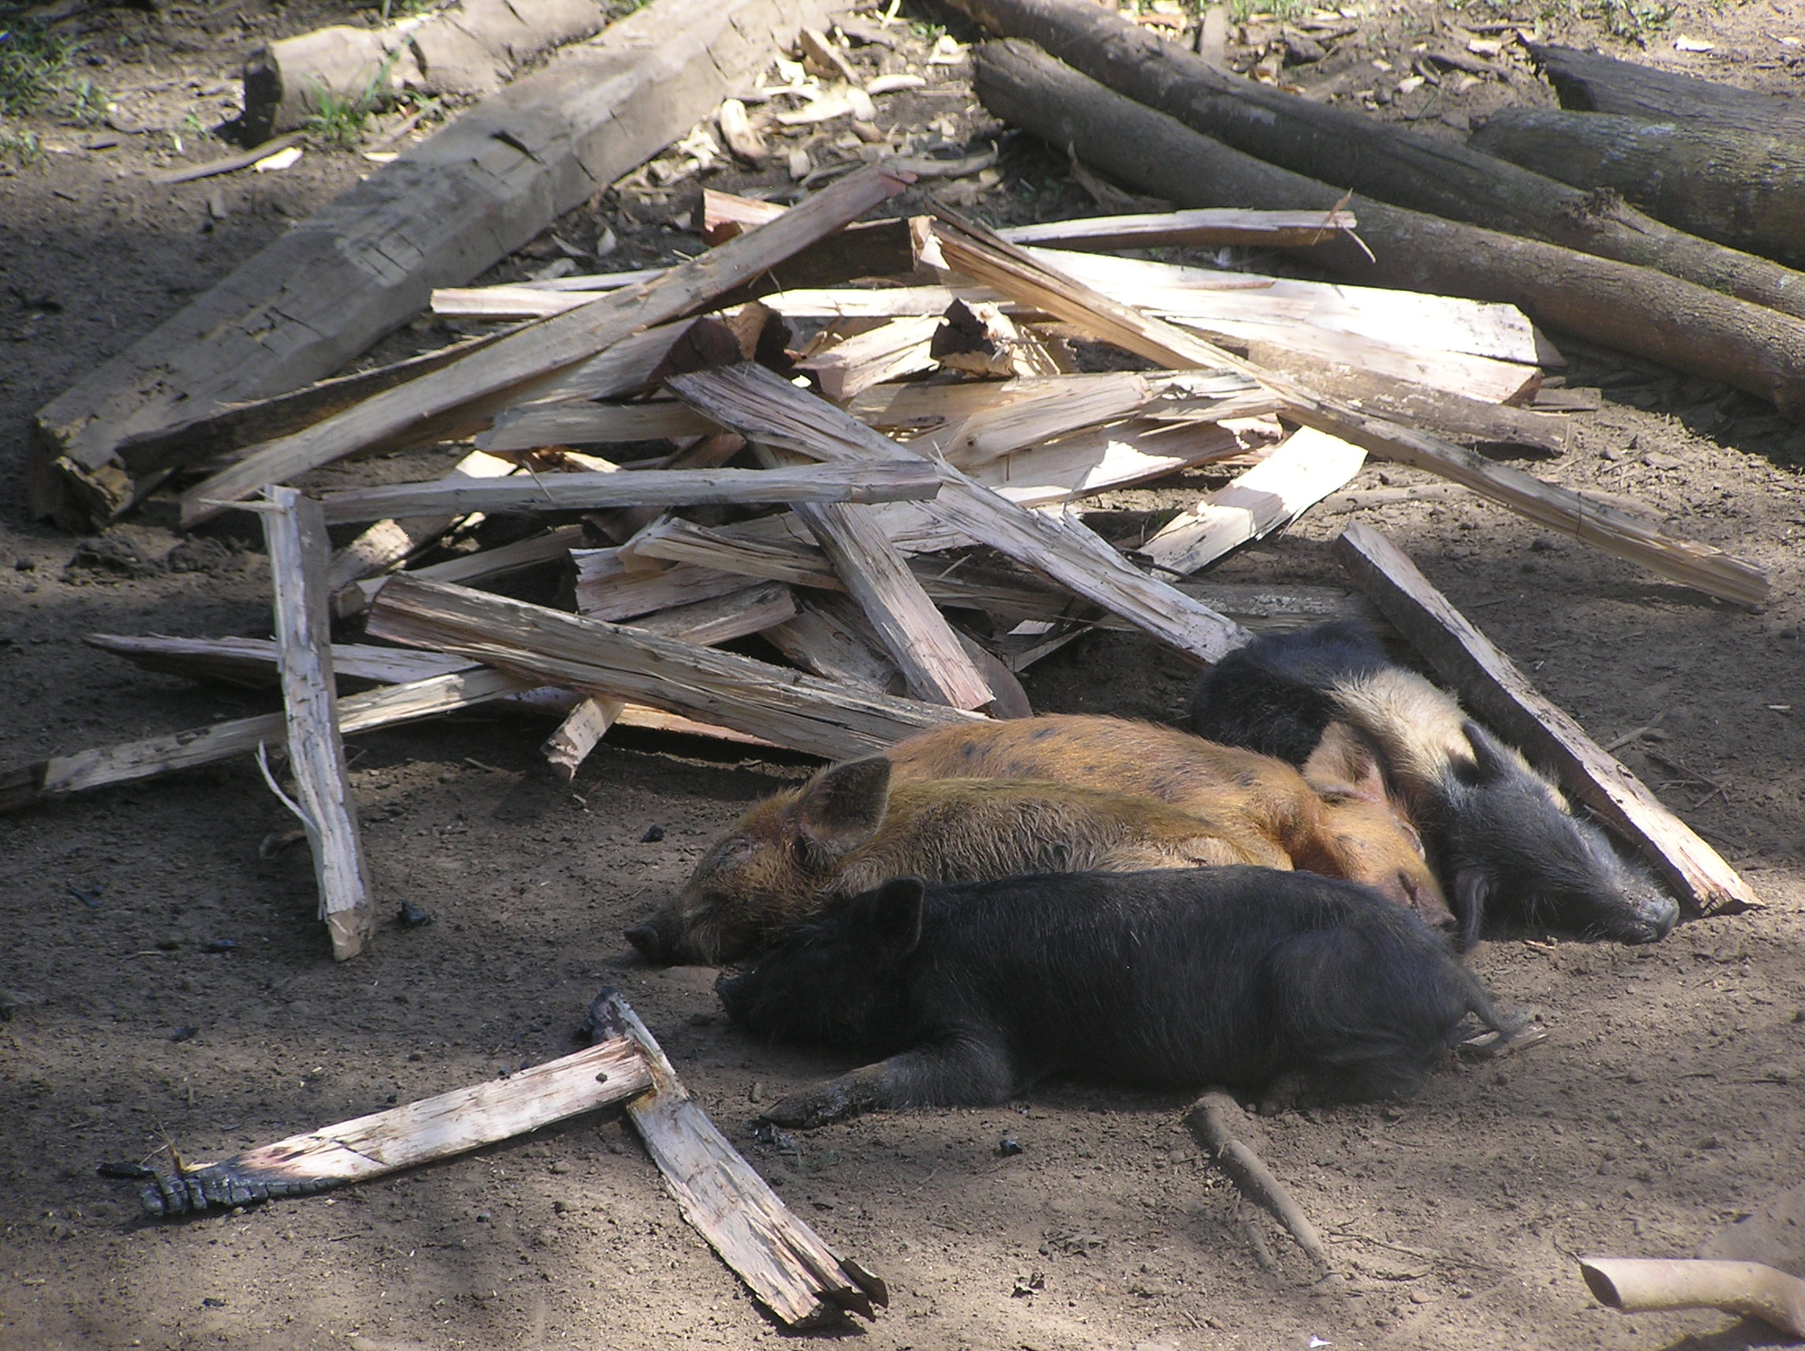
Wood to cook dinner with, collected from the jungle.

Slide 11
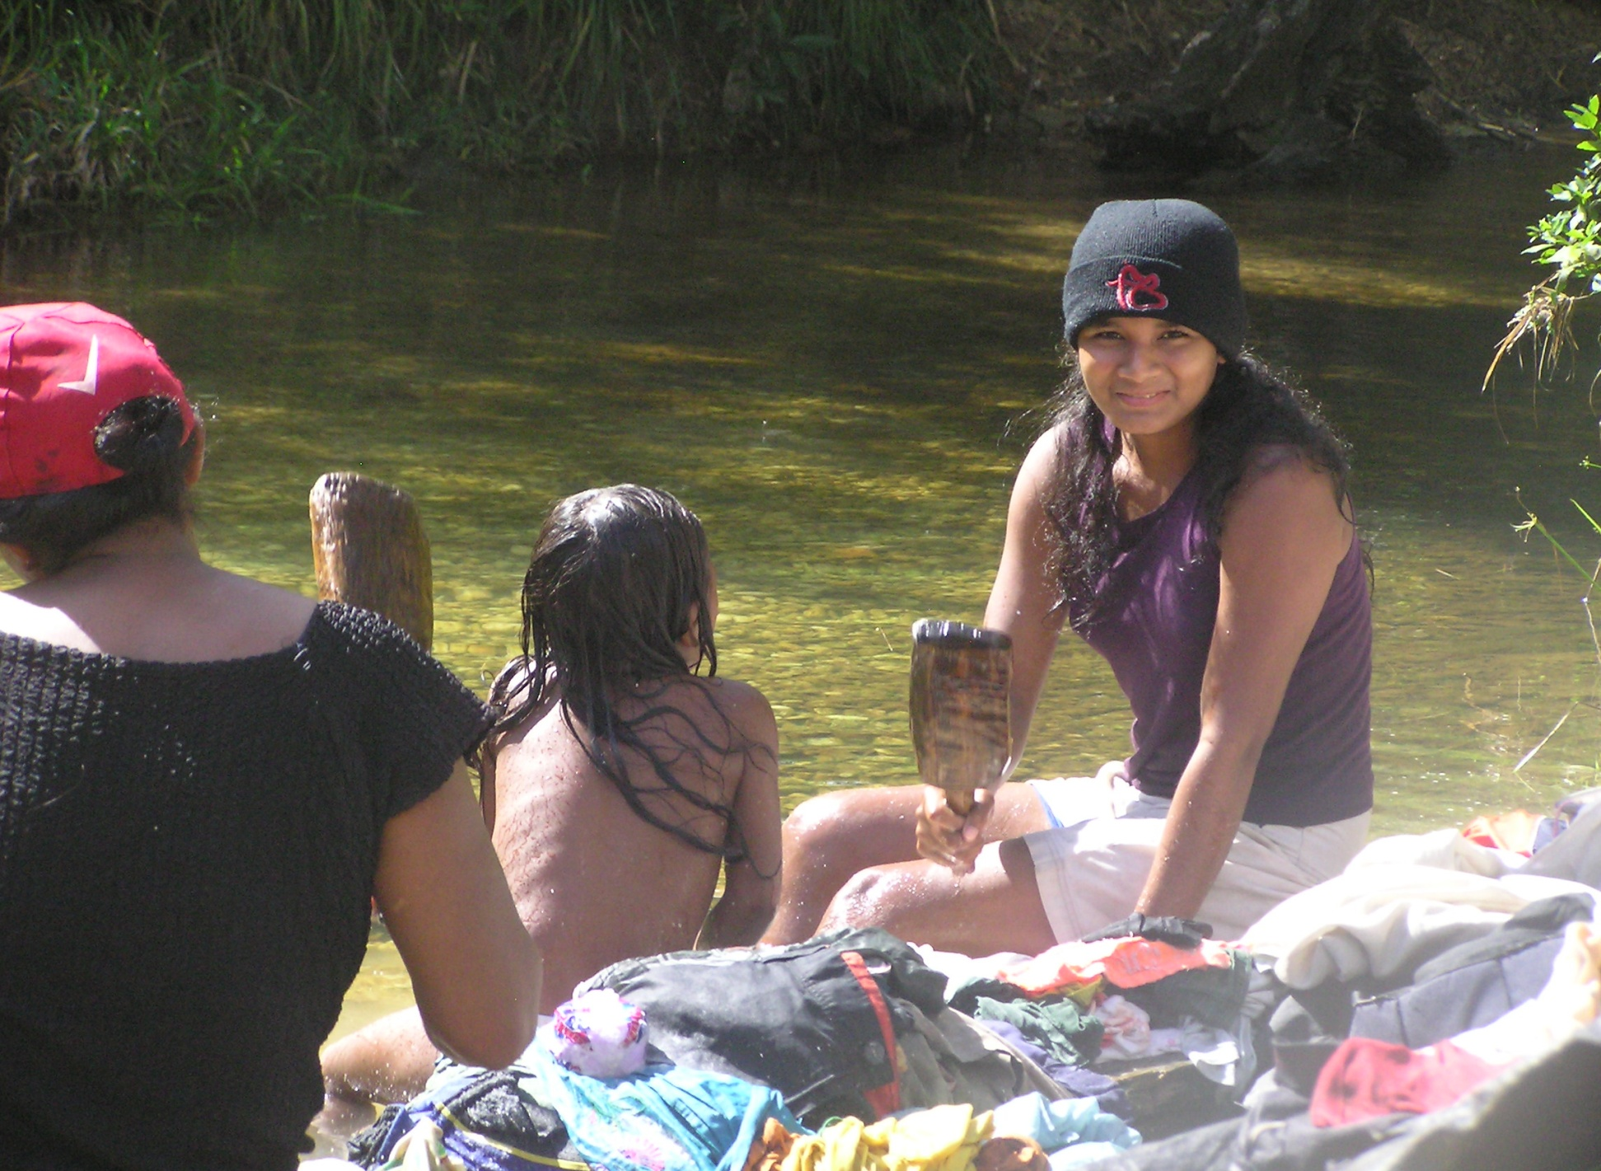
Cleaning clothes

Slide 12
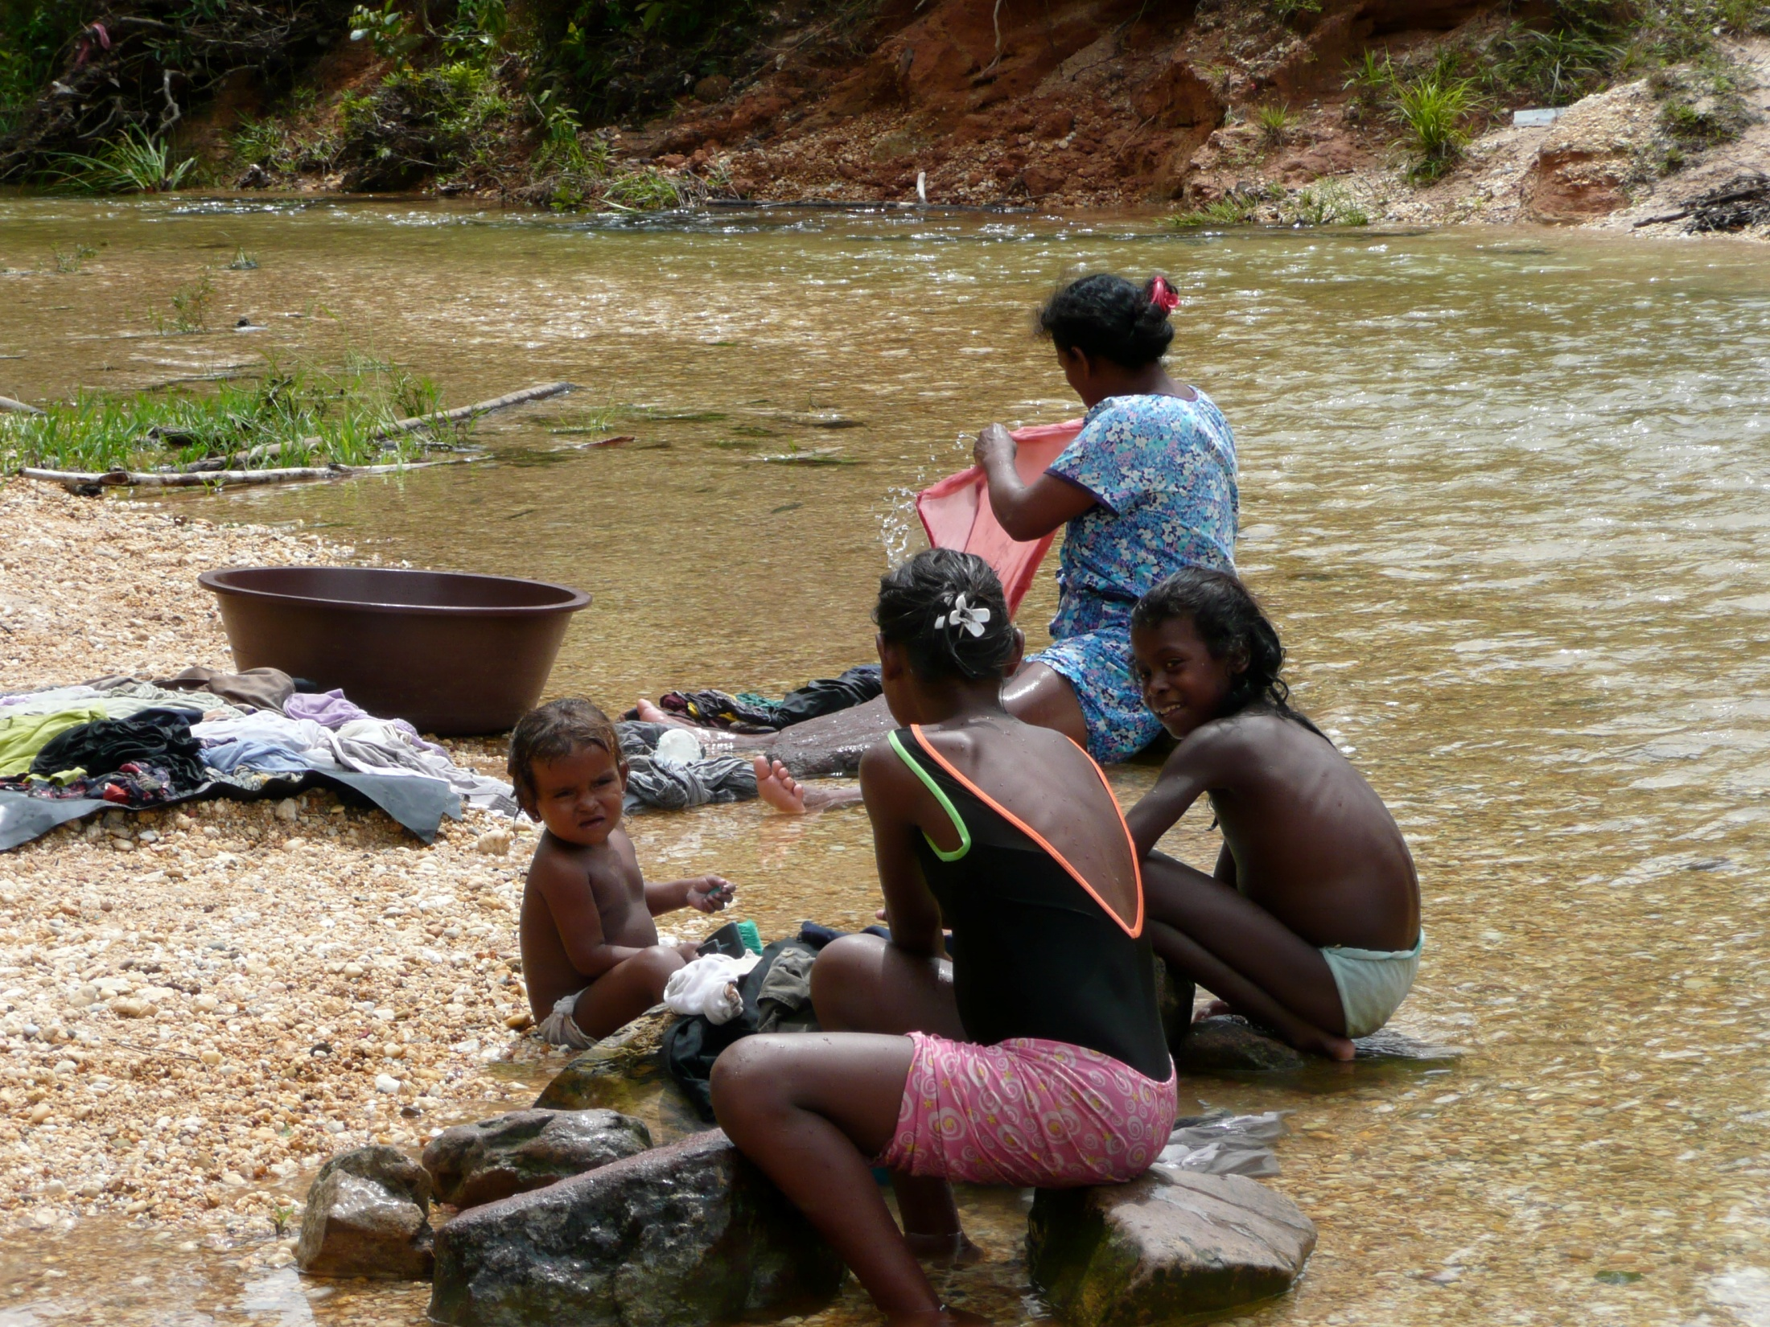
Another way to clean clothes

Slide 13
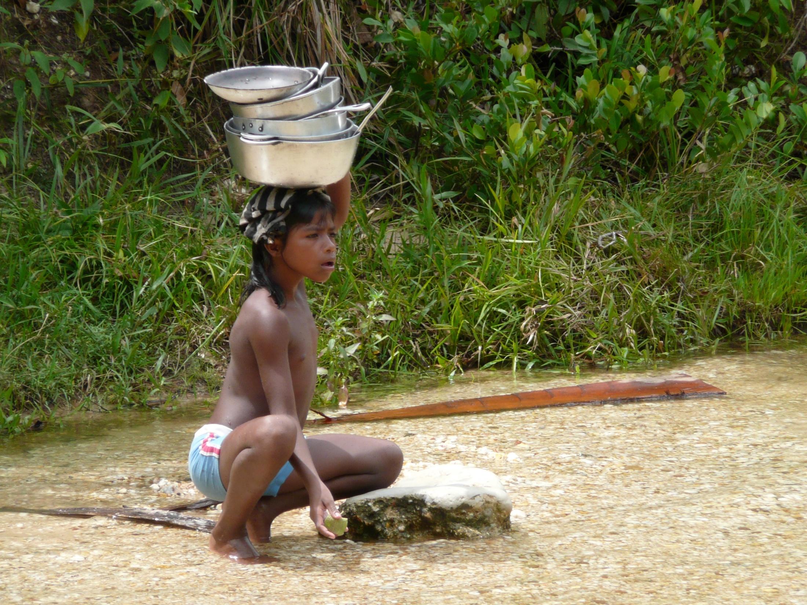
Doing the dishes

Slide 14
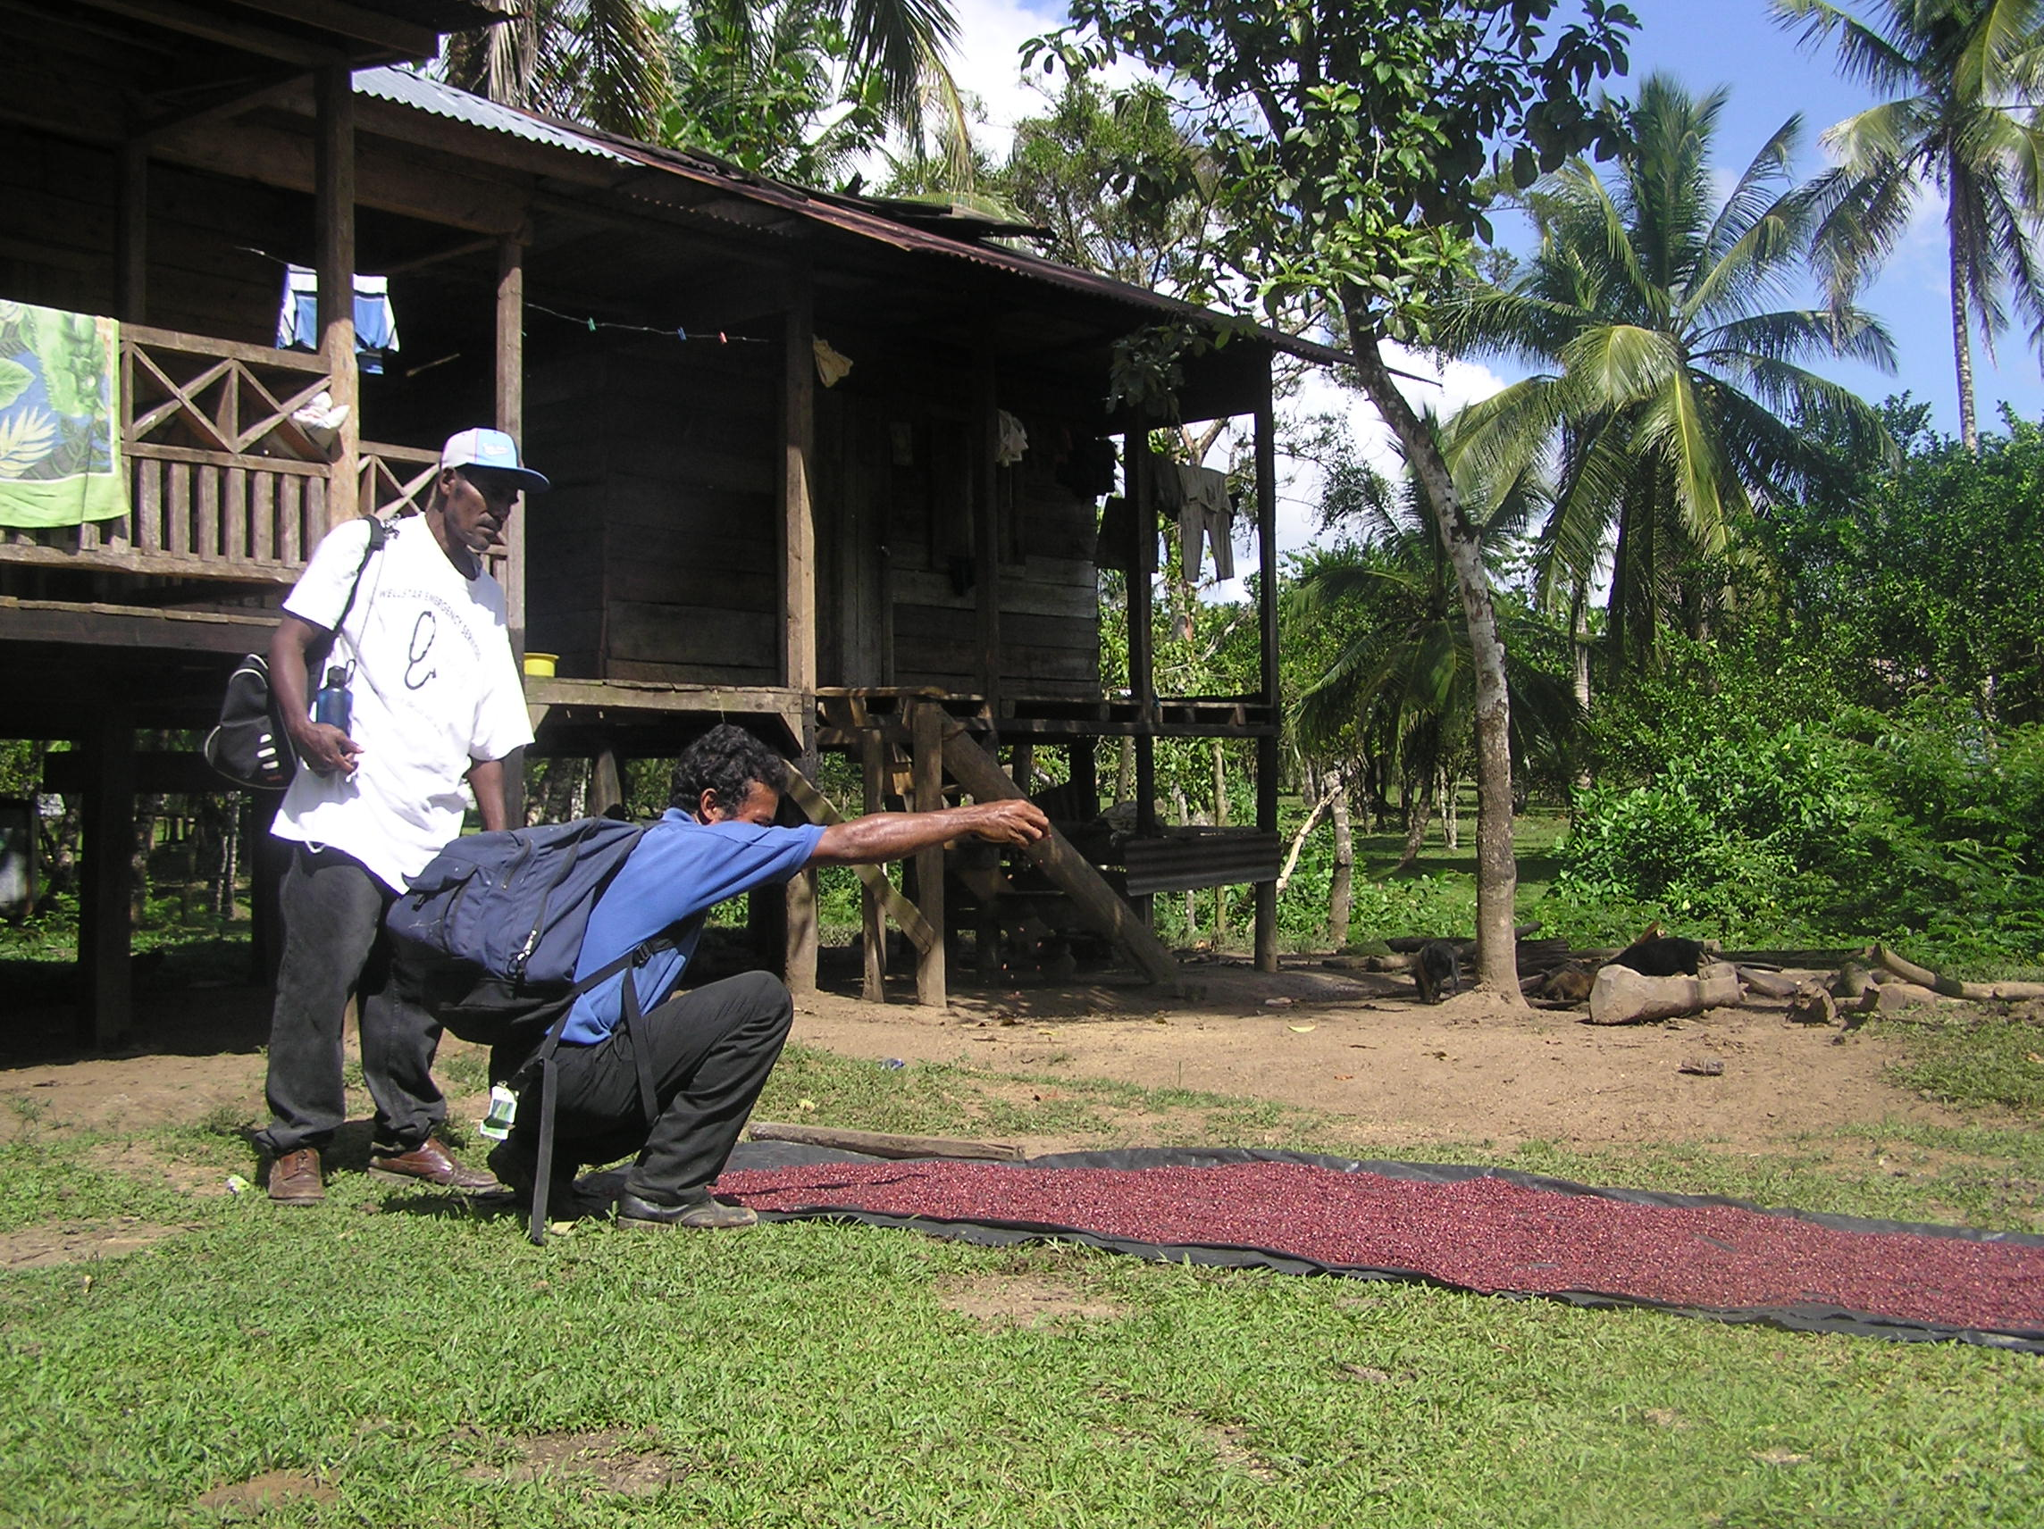
Drying beans. First you prepare the earth, then you plant them, then you harvest them, then you dry them.

Slide 15
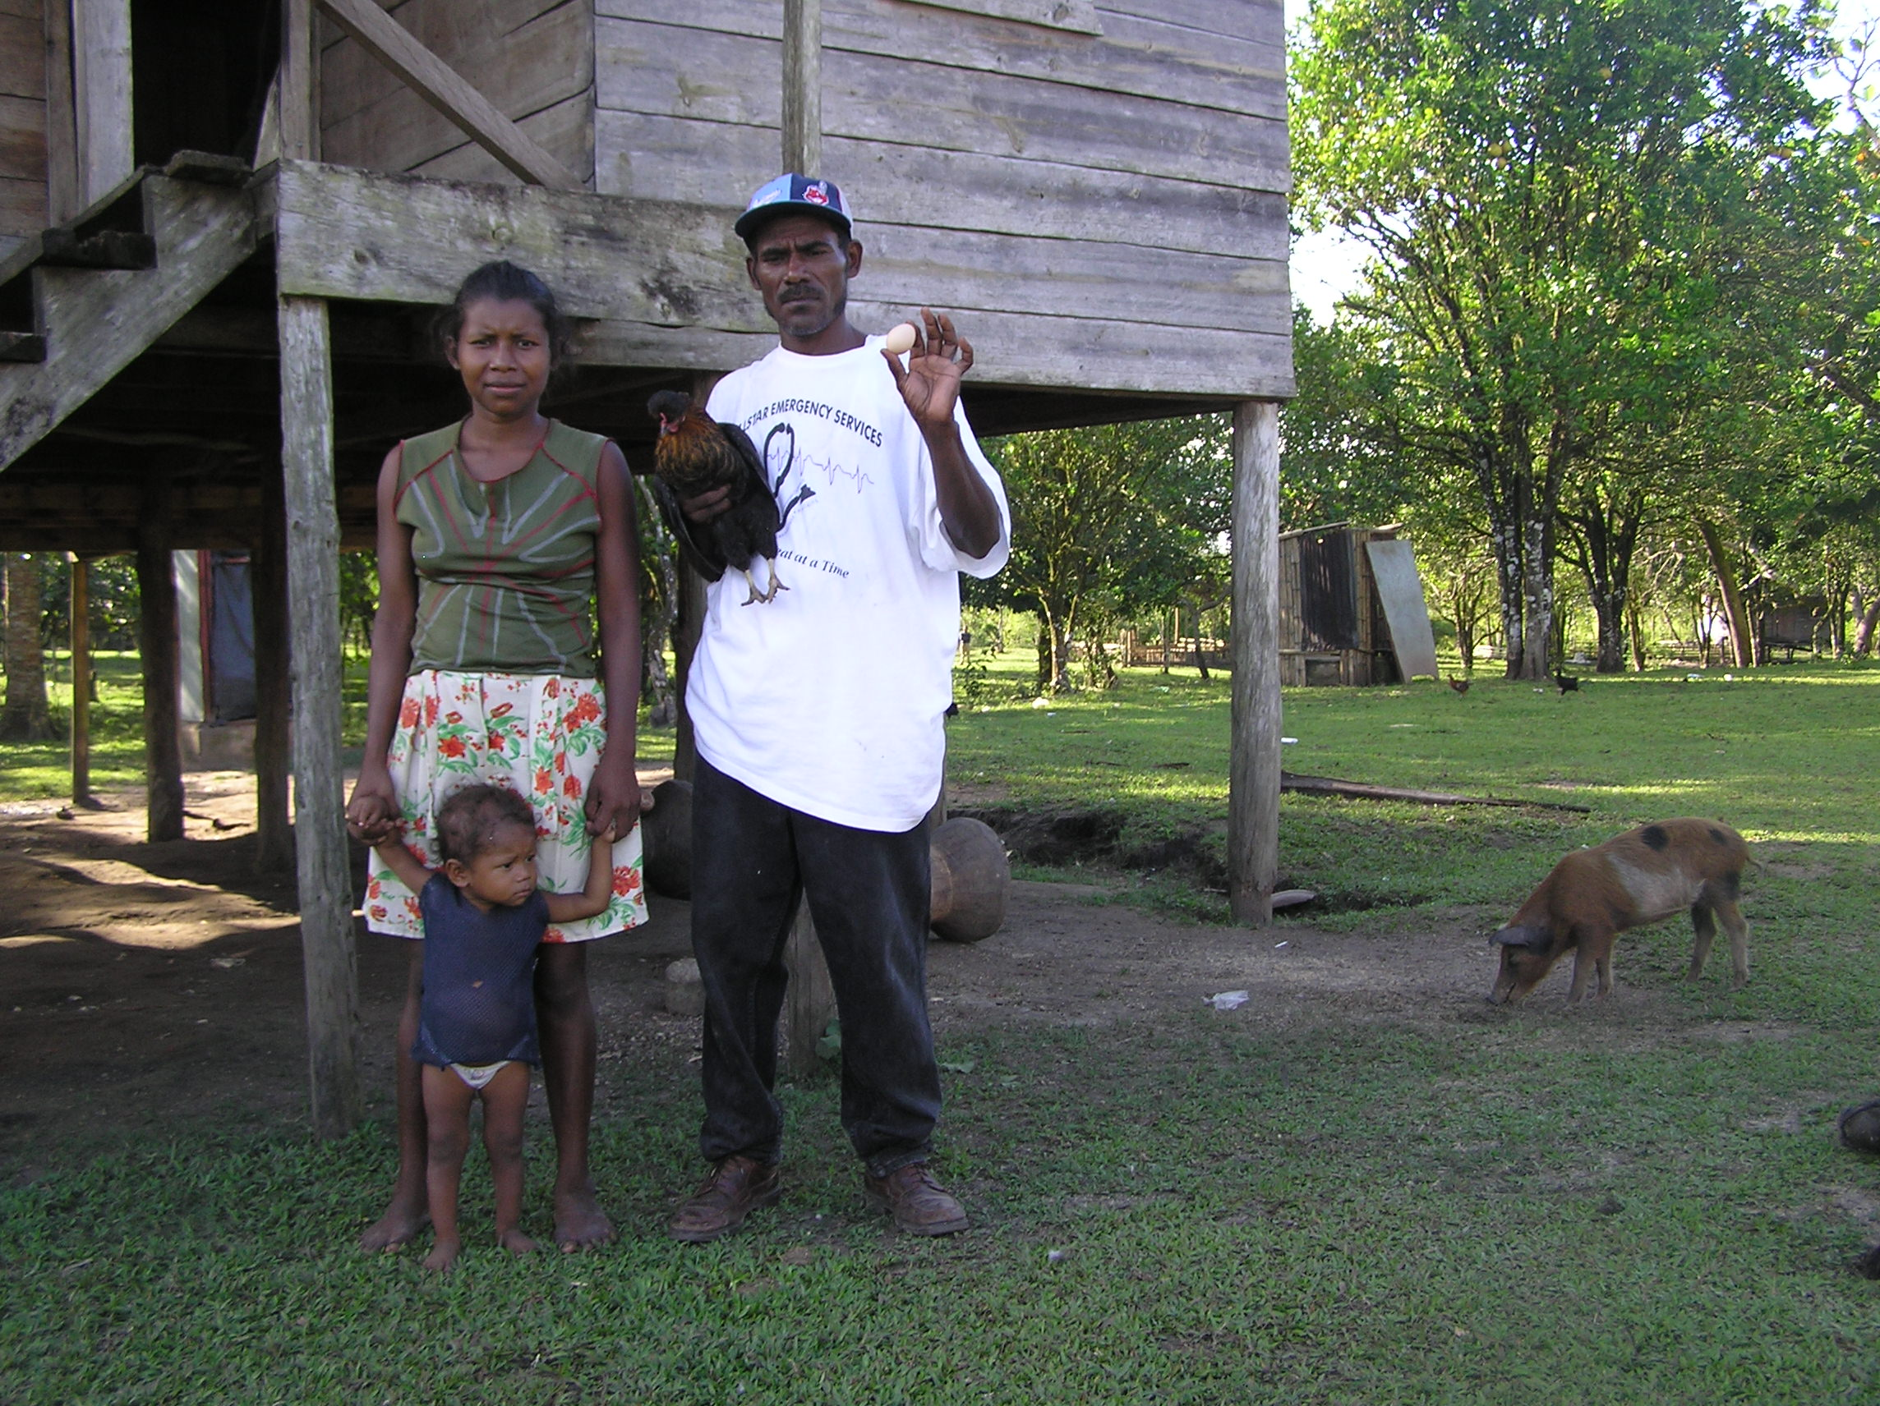
A Miskito family with their hen and pig.
Outhouse (bathroom) in the background.

Slide 16
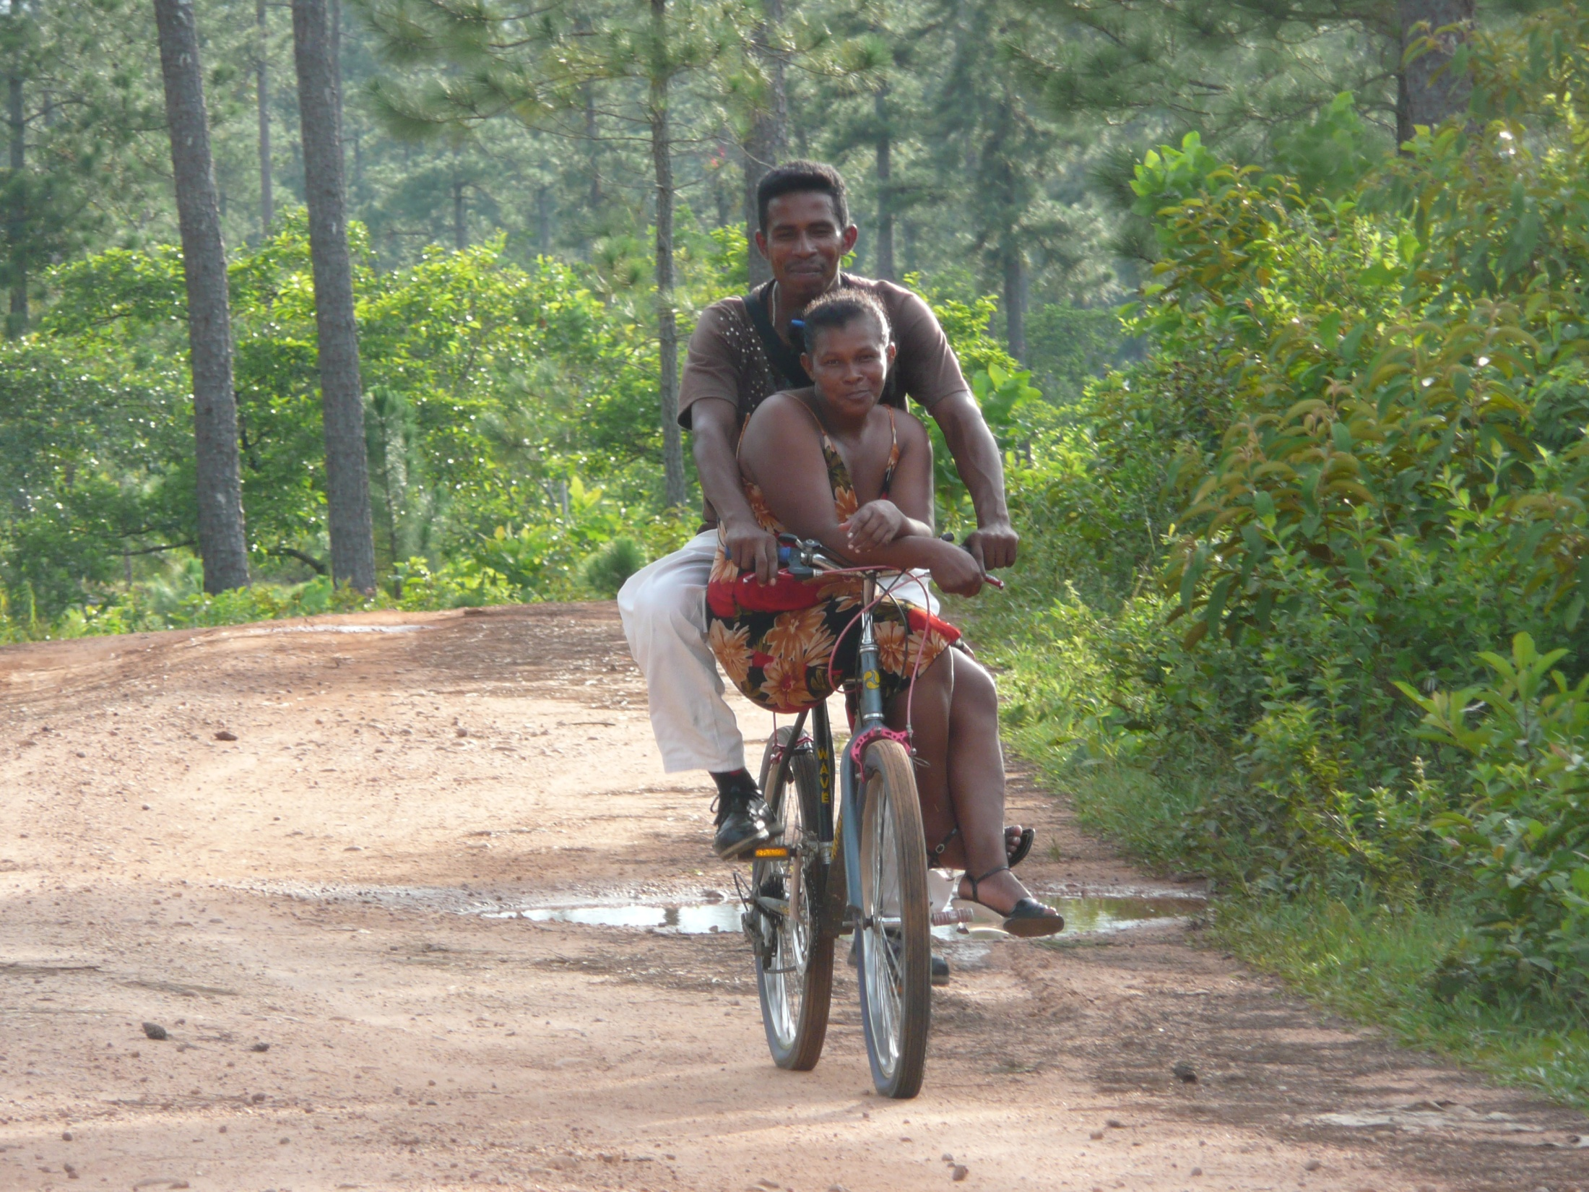
Most people don’t own a car.
Many don’t even own bicycles.

Slide 17
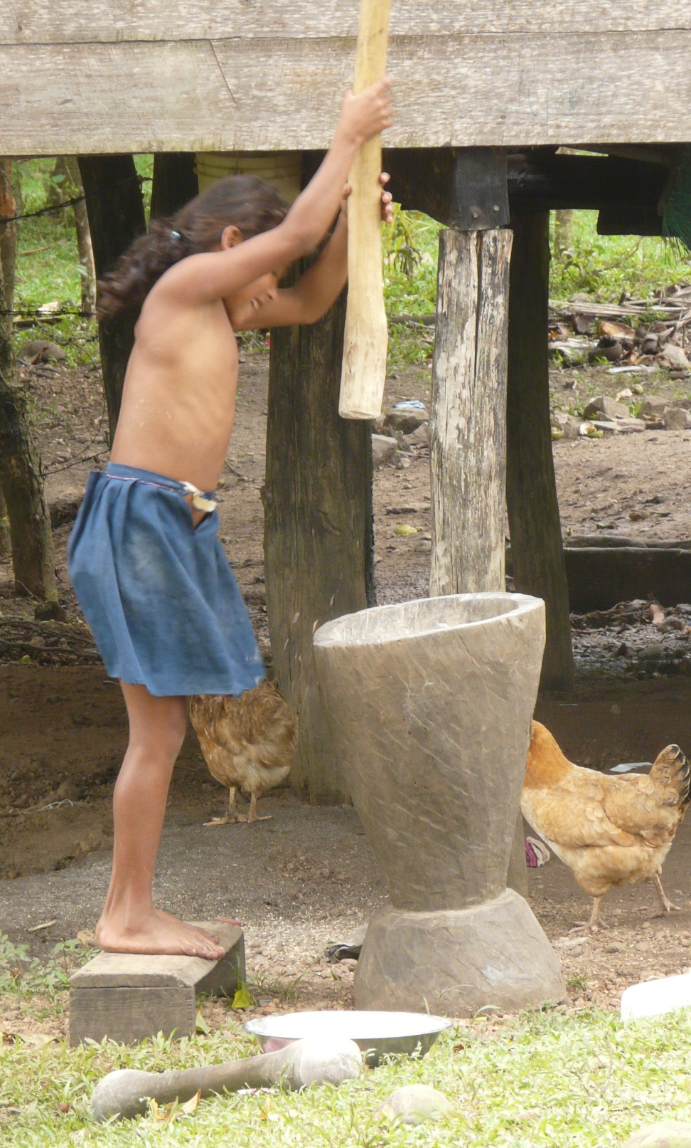
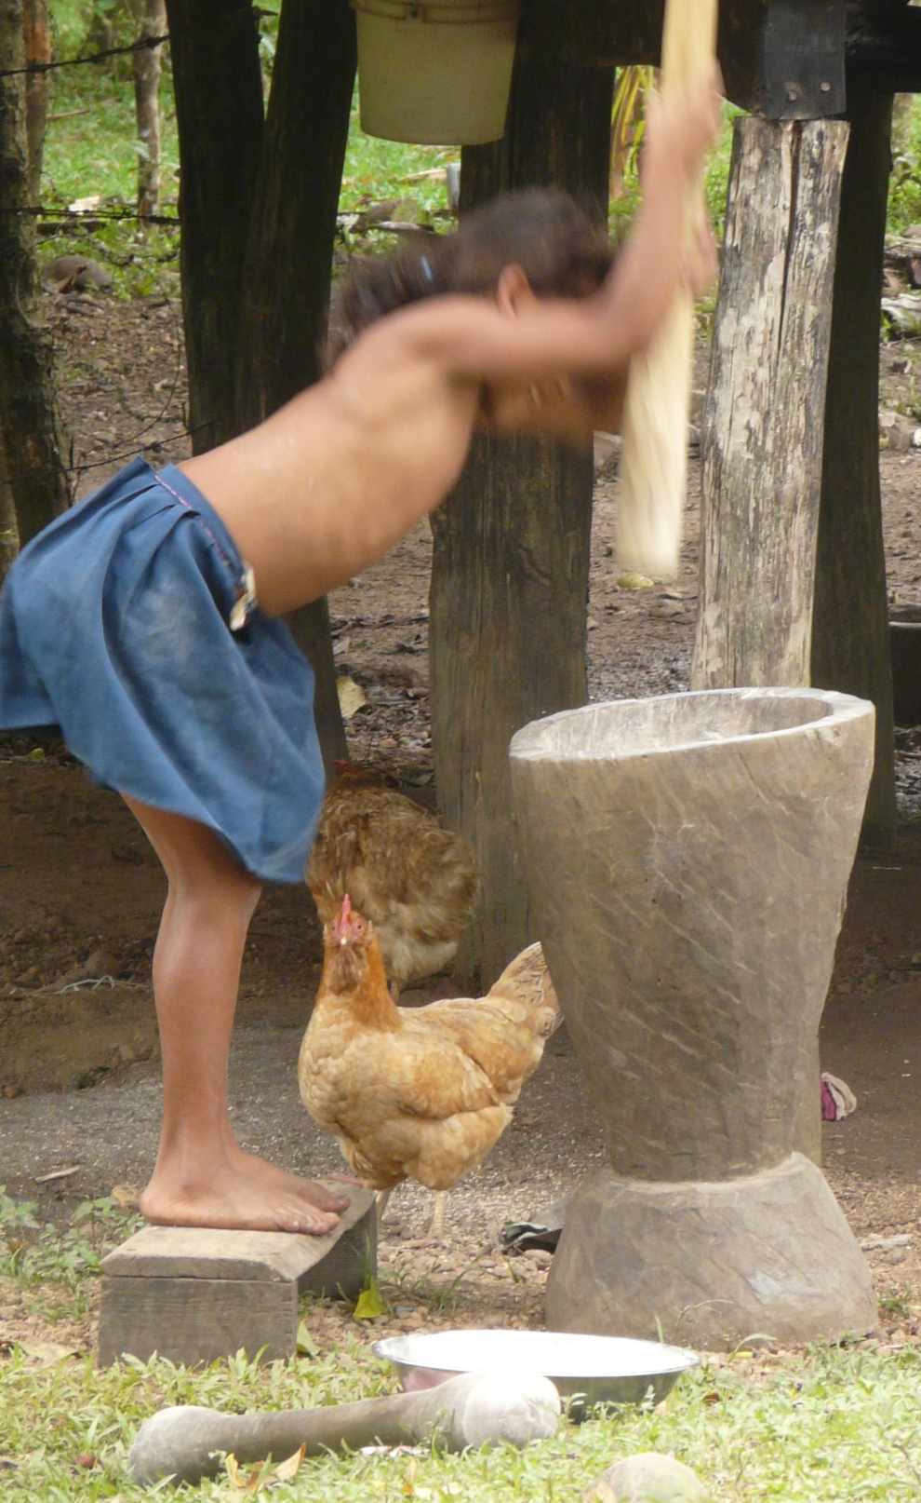
Grinding rice to remove the hulls (the outside).
Notes:
Kids go to school half a day from Kindergarten to 6th grade, then they play or help their parents watch younger kids, de-hull rice. Older kids help by gathering food from the jungle, mostly digging yucca or picking bananas and coconuts. Some older kids get to go to high school, but most finish school by 6th grade, then start working .

Slide 18
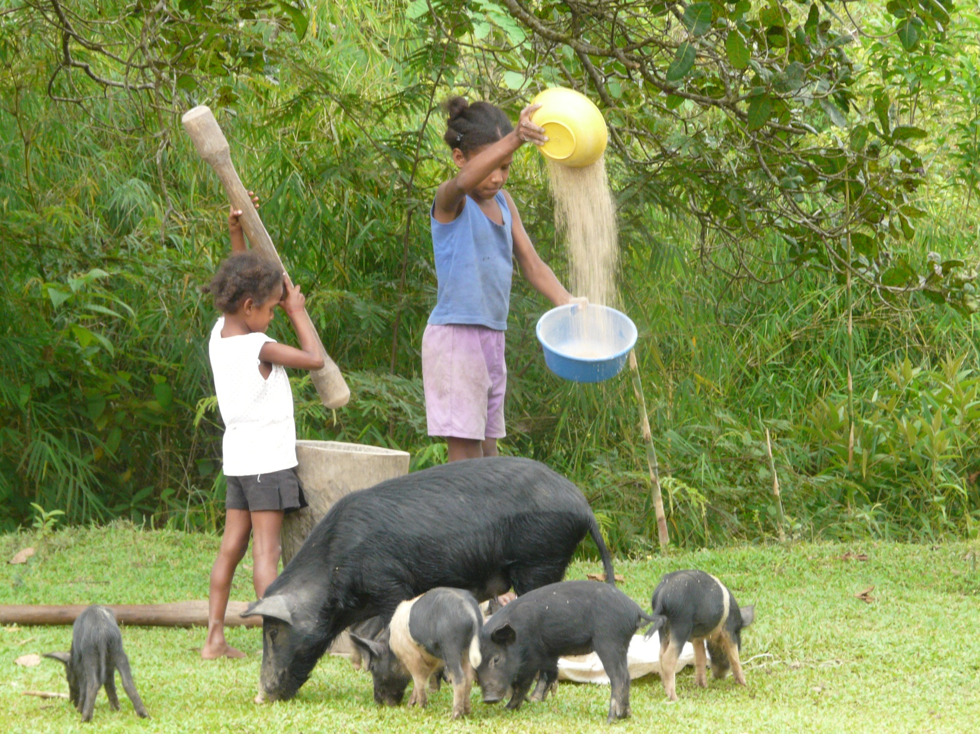
Separating the rice from the chaff.

Slide 19
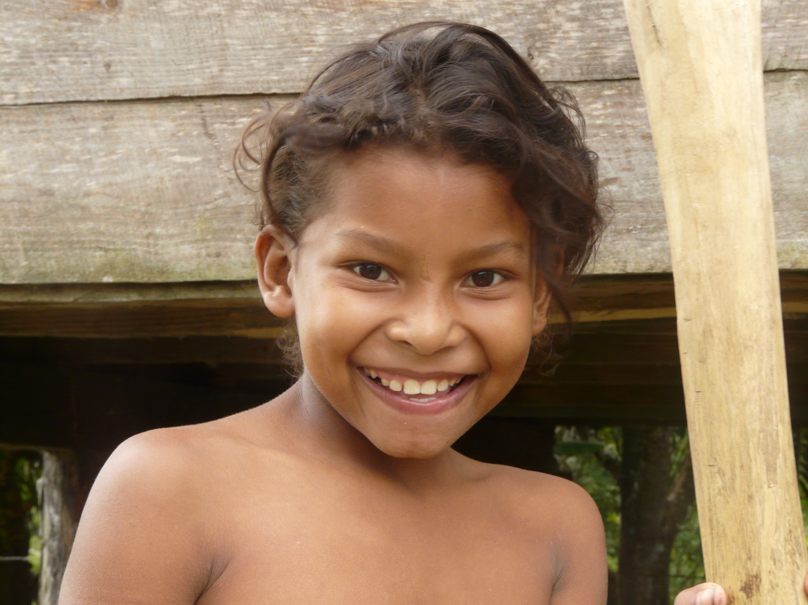

Slide 20
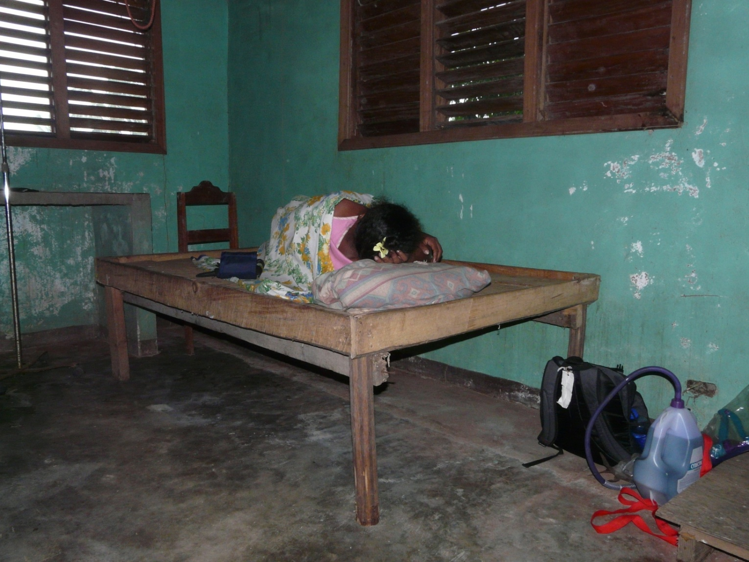
The Hospital.
Notes:
If you get hurt, you may not be able to go to the doctor, and even if you can, the doctor may not have the medicine you need to make you better..

Slide 21
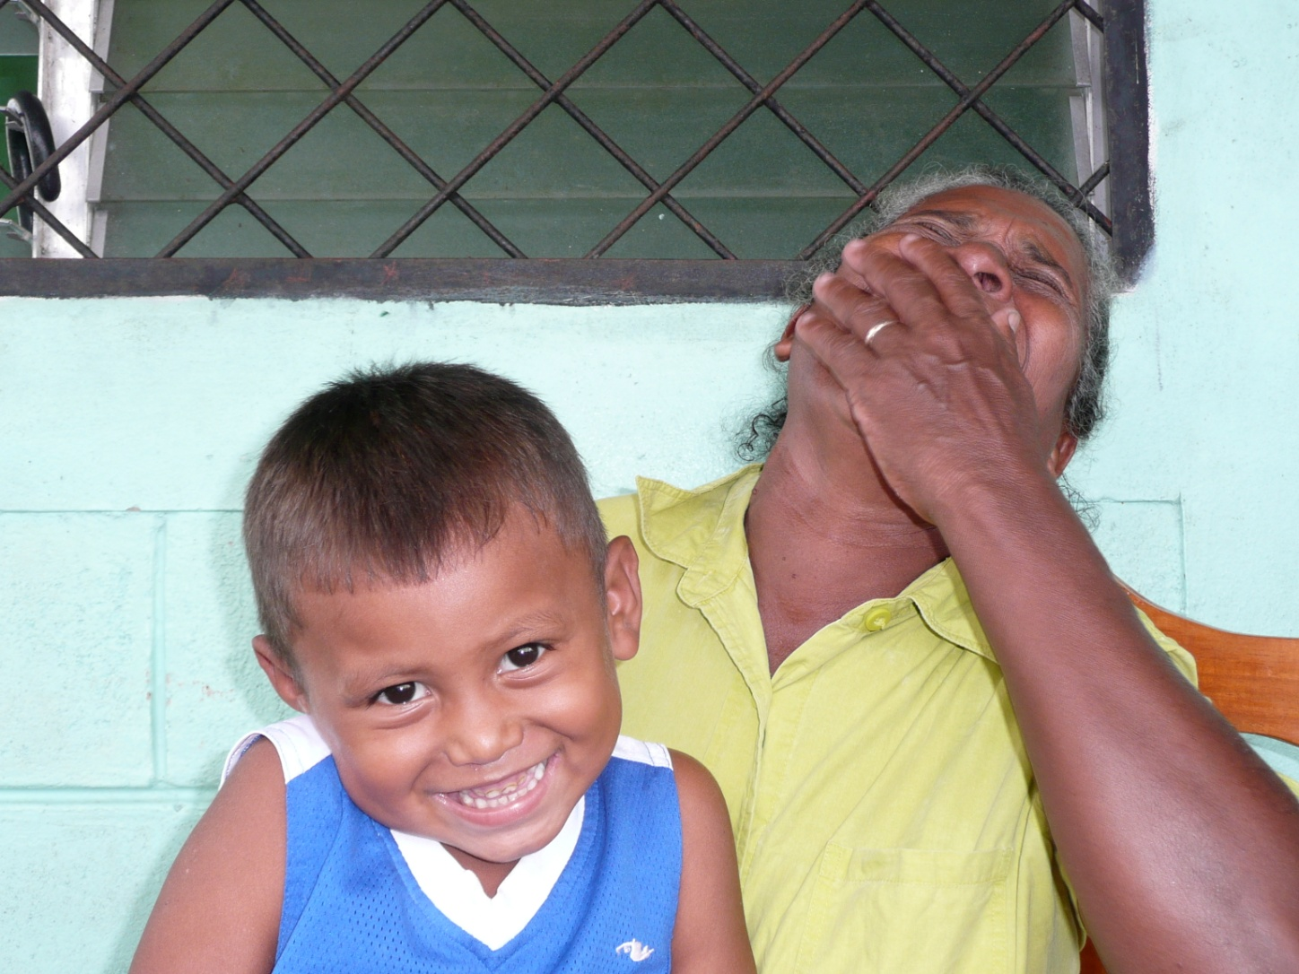
But life is fun! There is lots of time to hang out with friends and family, and many ways to play.

Slide 22
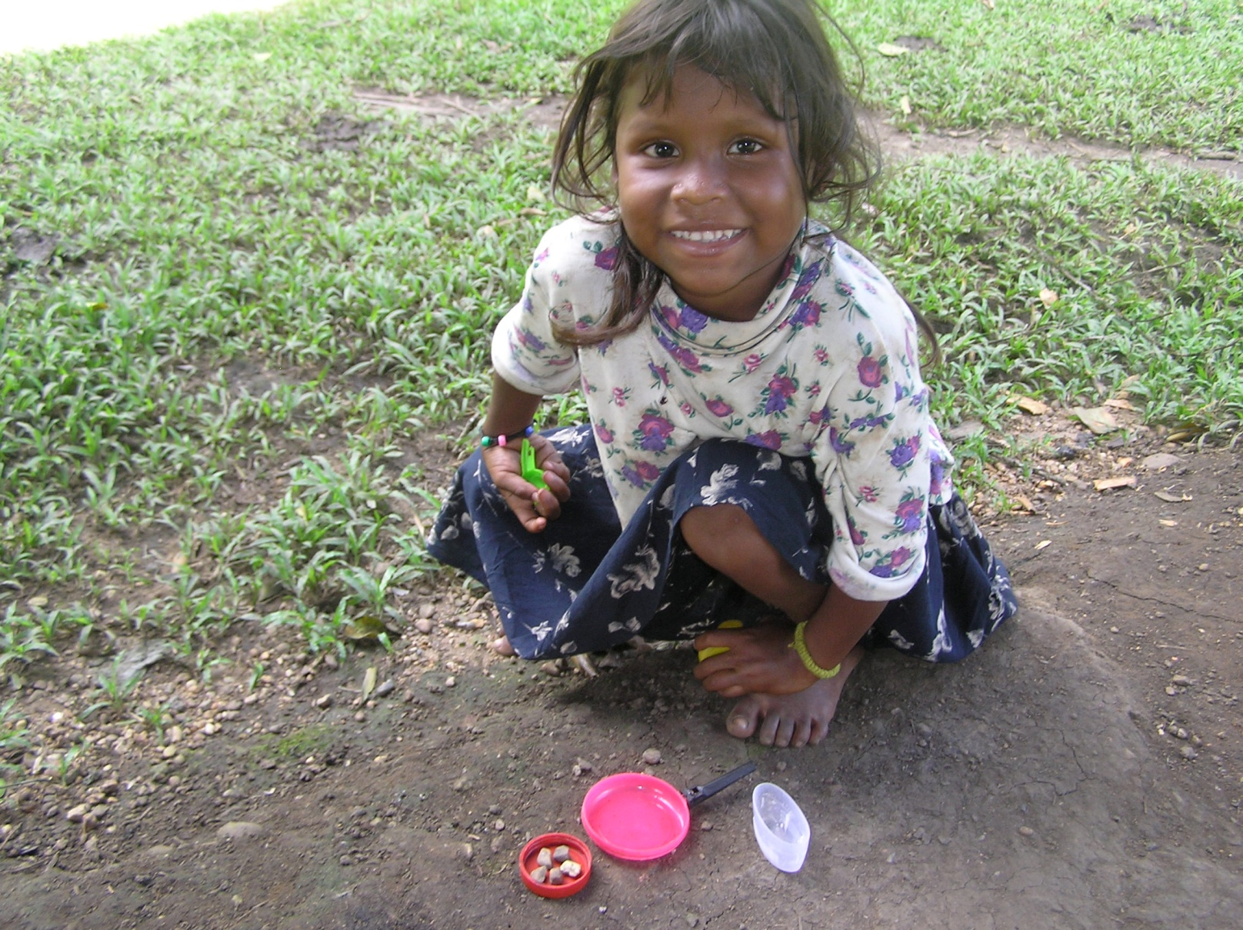
Miskito girl with her toys. Look at her smile! ☺

Slide 23
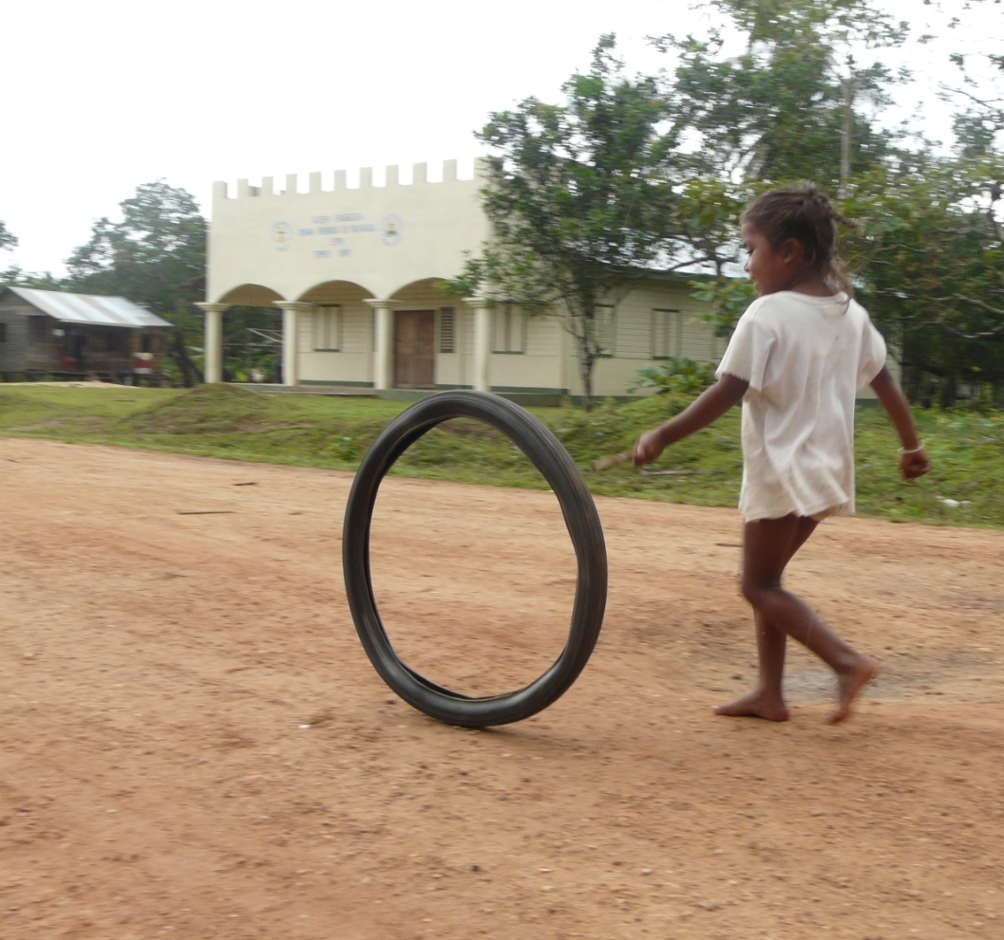
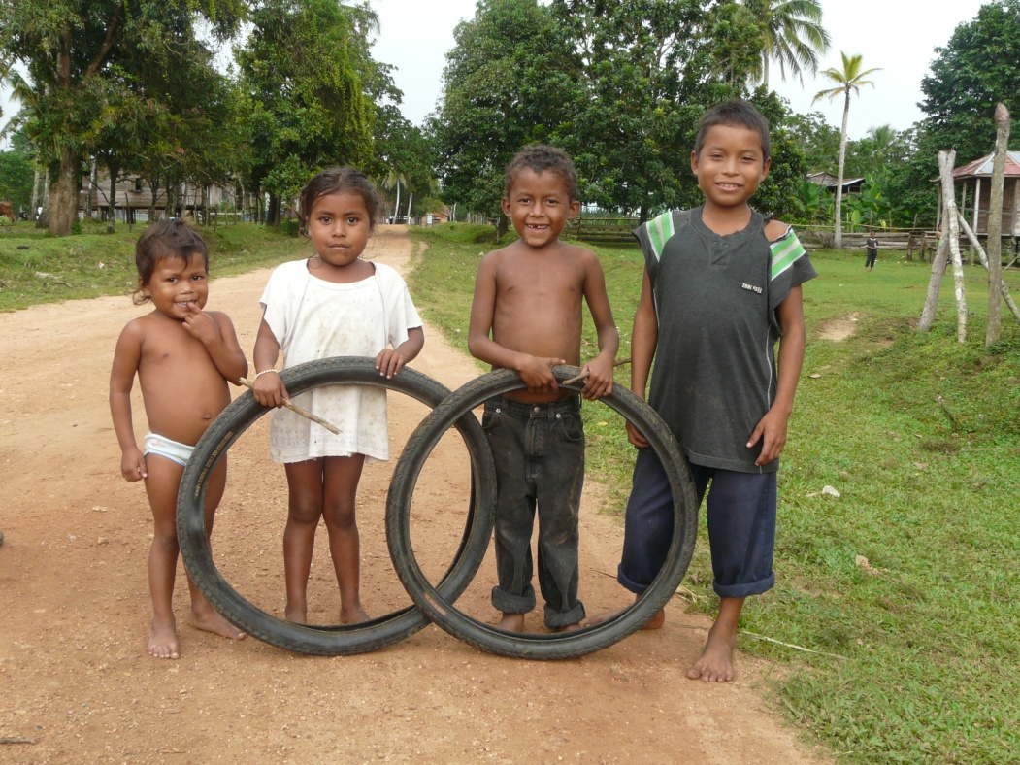
One of the most popular games: rolling an old bike tire with a stick.

Slide 24
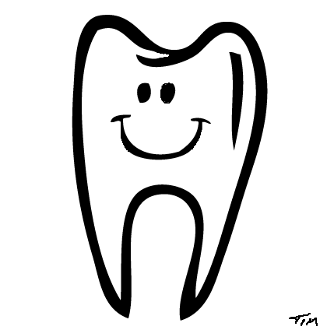
So what can we do to help
Save Their Smiles?

Slide 25
Save their Smiles
There are two parts of the project:
Desde el Primer Diente. 2. Cepilla en Escuela
(una parte de VPCD) (una trabaja de los maestros)
From the First Tooth
A program for kids from
birth to 4 years of age
Brush at School
A program for kids 4 - 17 years of age

Slide 26
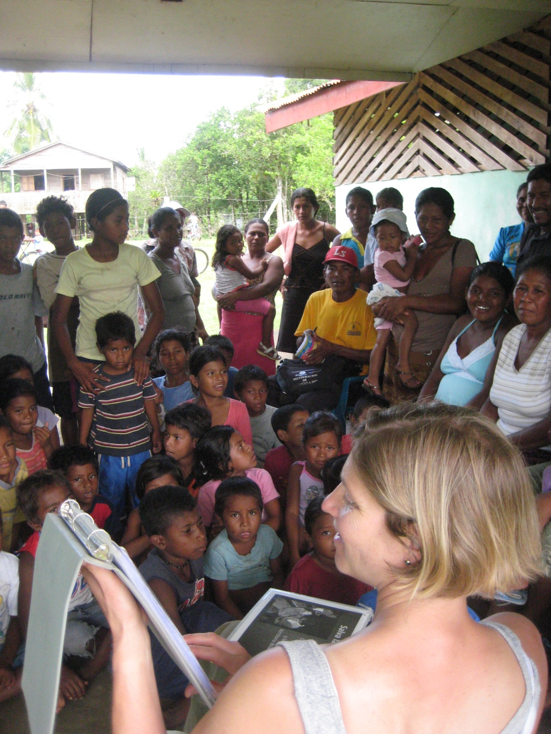
From the First Tooth.

Slide 27
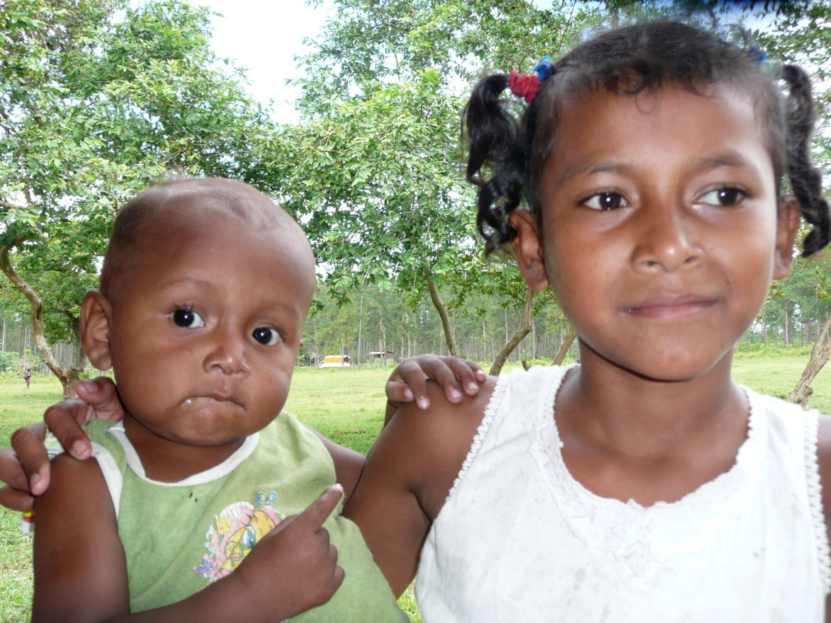
For the Babies: Teach the parents.
  To start brushing when they see their baby’s FIRST TOOTH.
  No sweets for babies! Milk and healthy food only.
  To take their kids to the dentist twice/year.

Slide 28
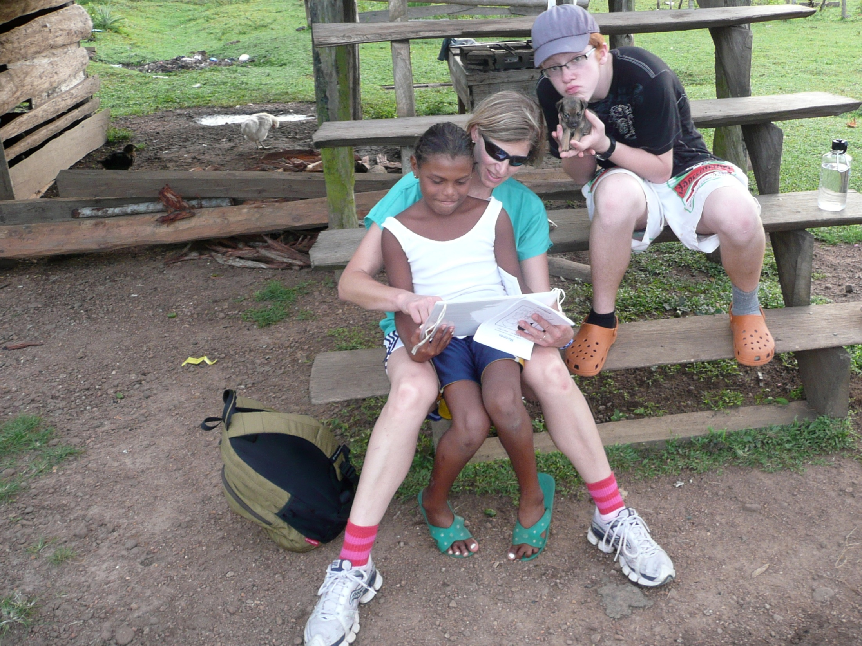
Read books about brushing teeth.

Slide 29
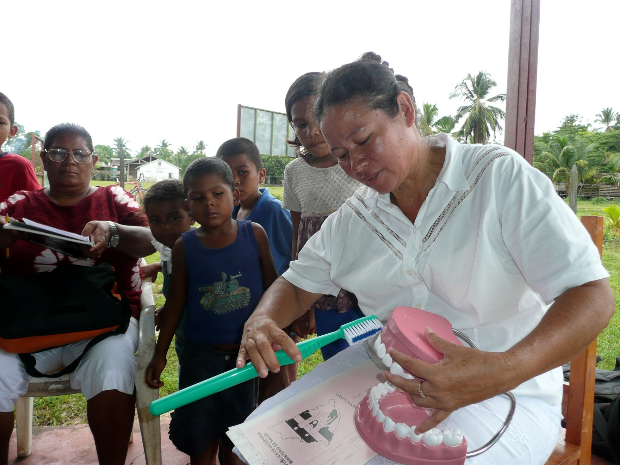
Teach parents how to brush their kids teeth.

Slide 30
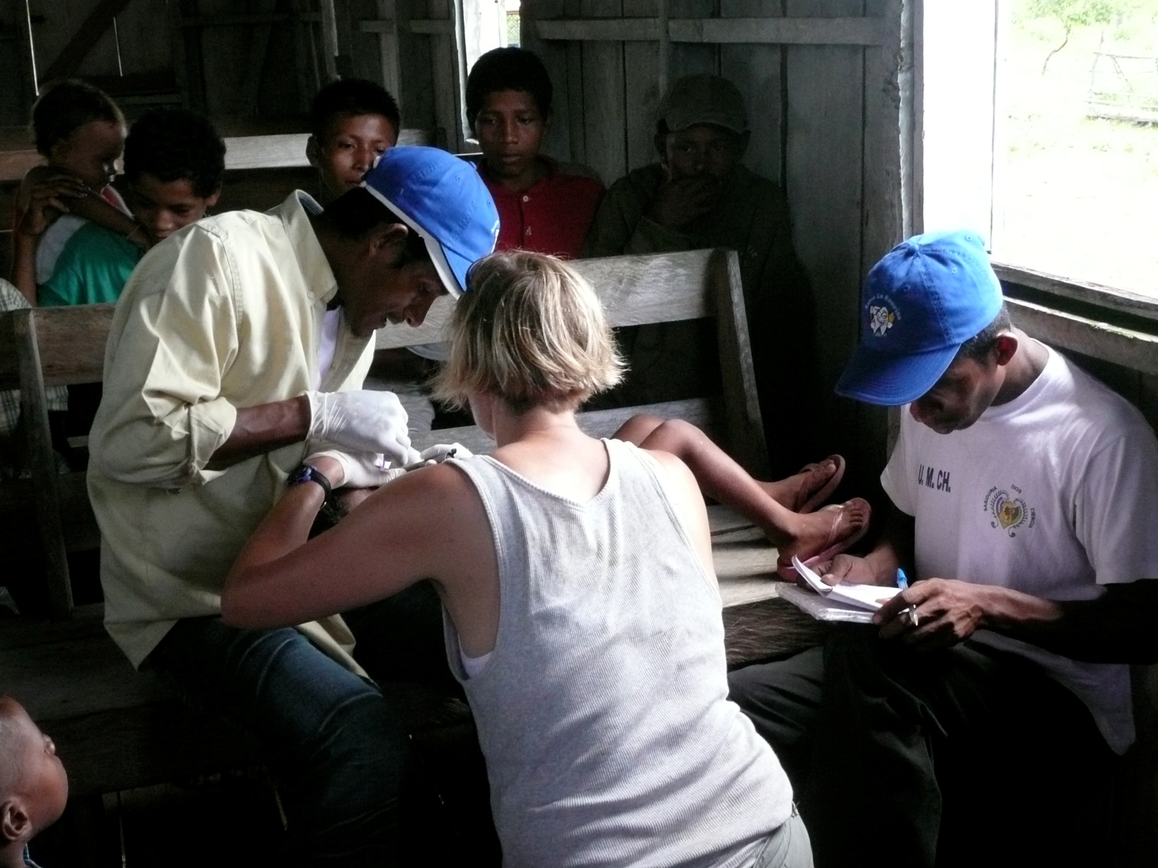
Train local outreach workers to evaluate for cavities.

Slide 31
Brush at School- a program to teach teachers how to brush and to establish the routine of brushing for their students.

Slide 32
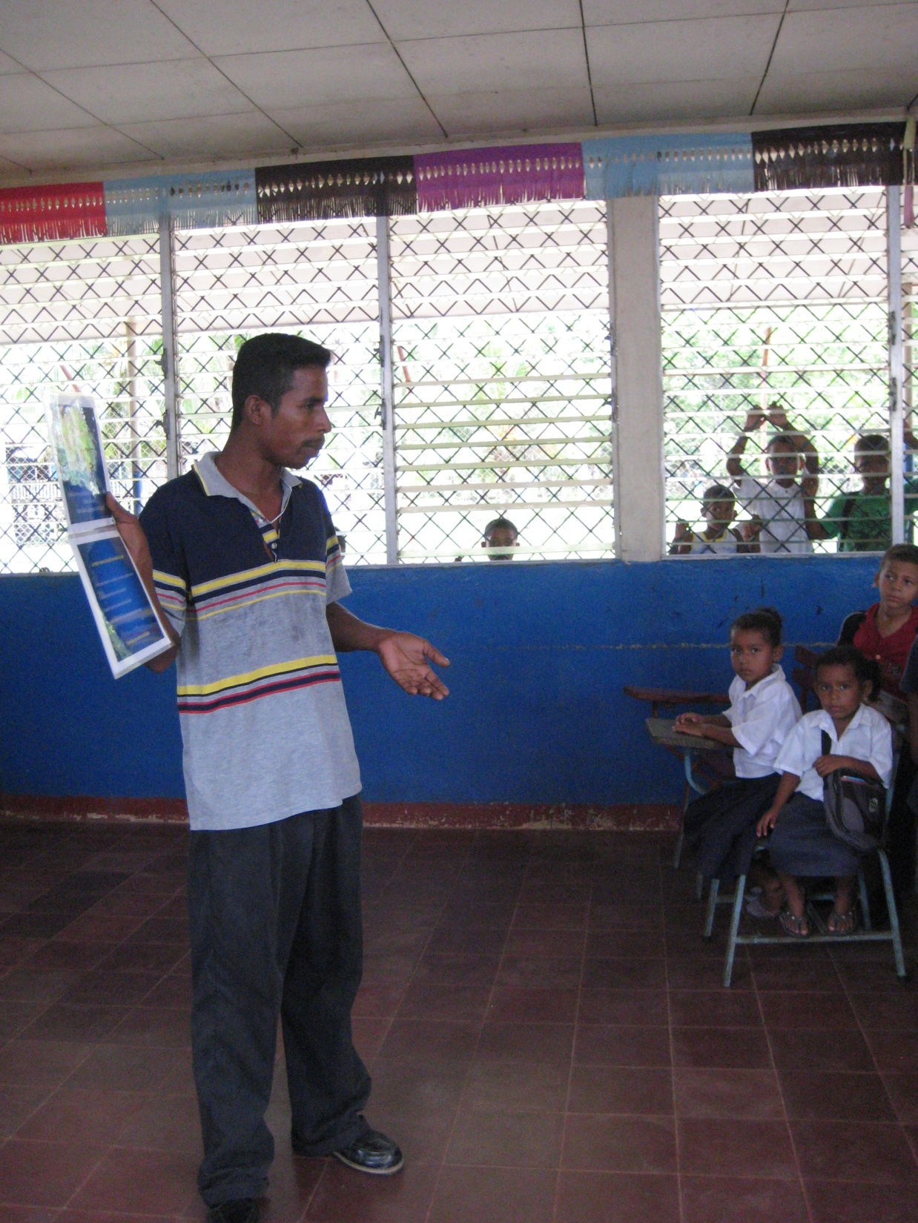
After I train the leaders, they train the teachers, parents, and kids.
There are no books or paper in schools. No crayons. No water.

Slide 33
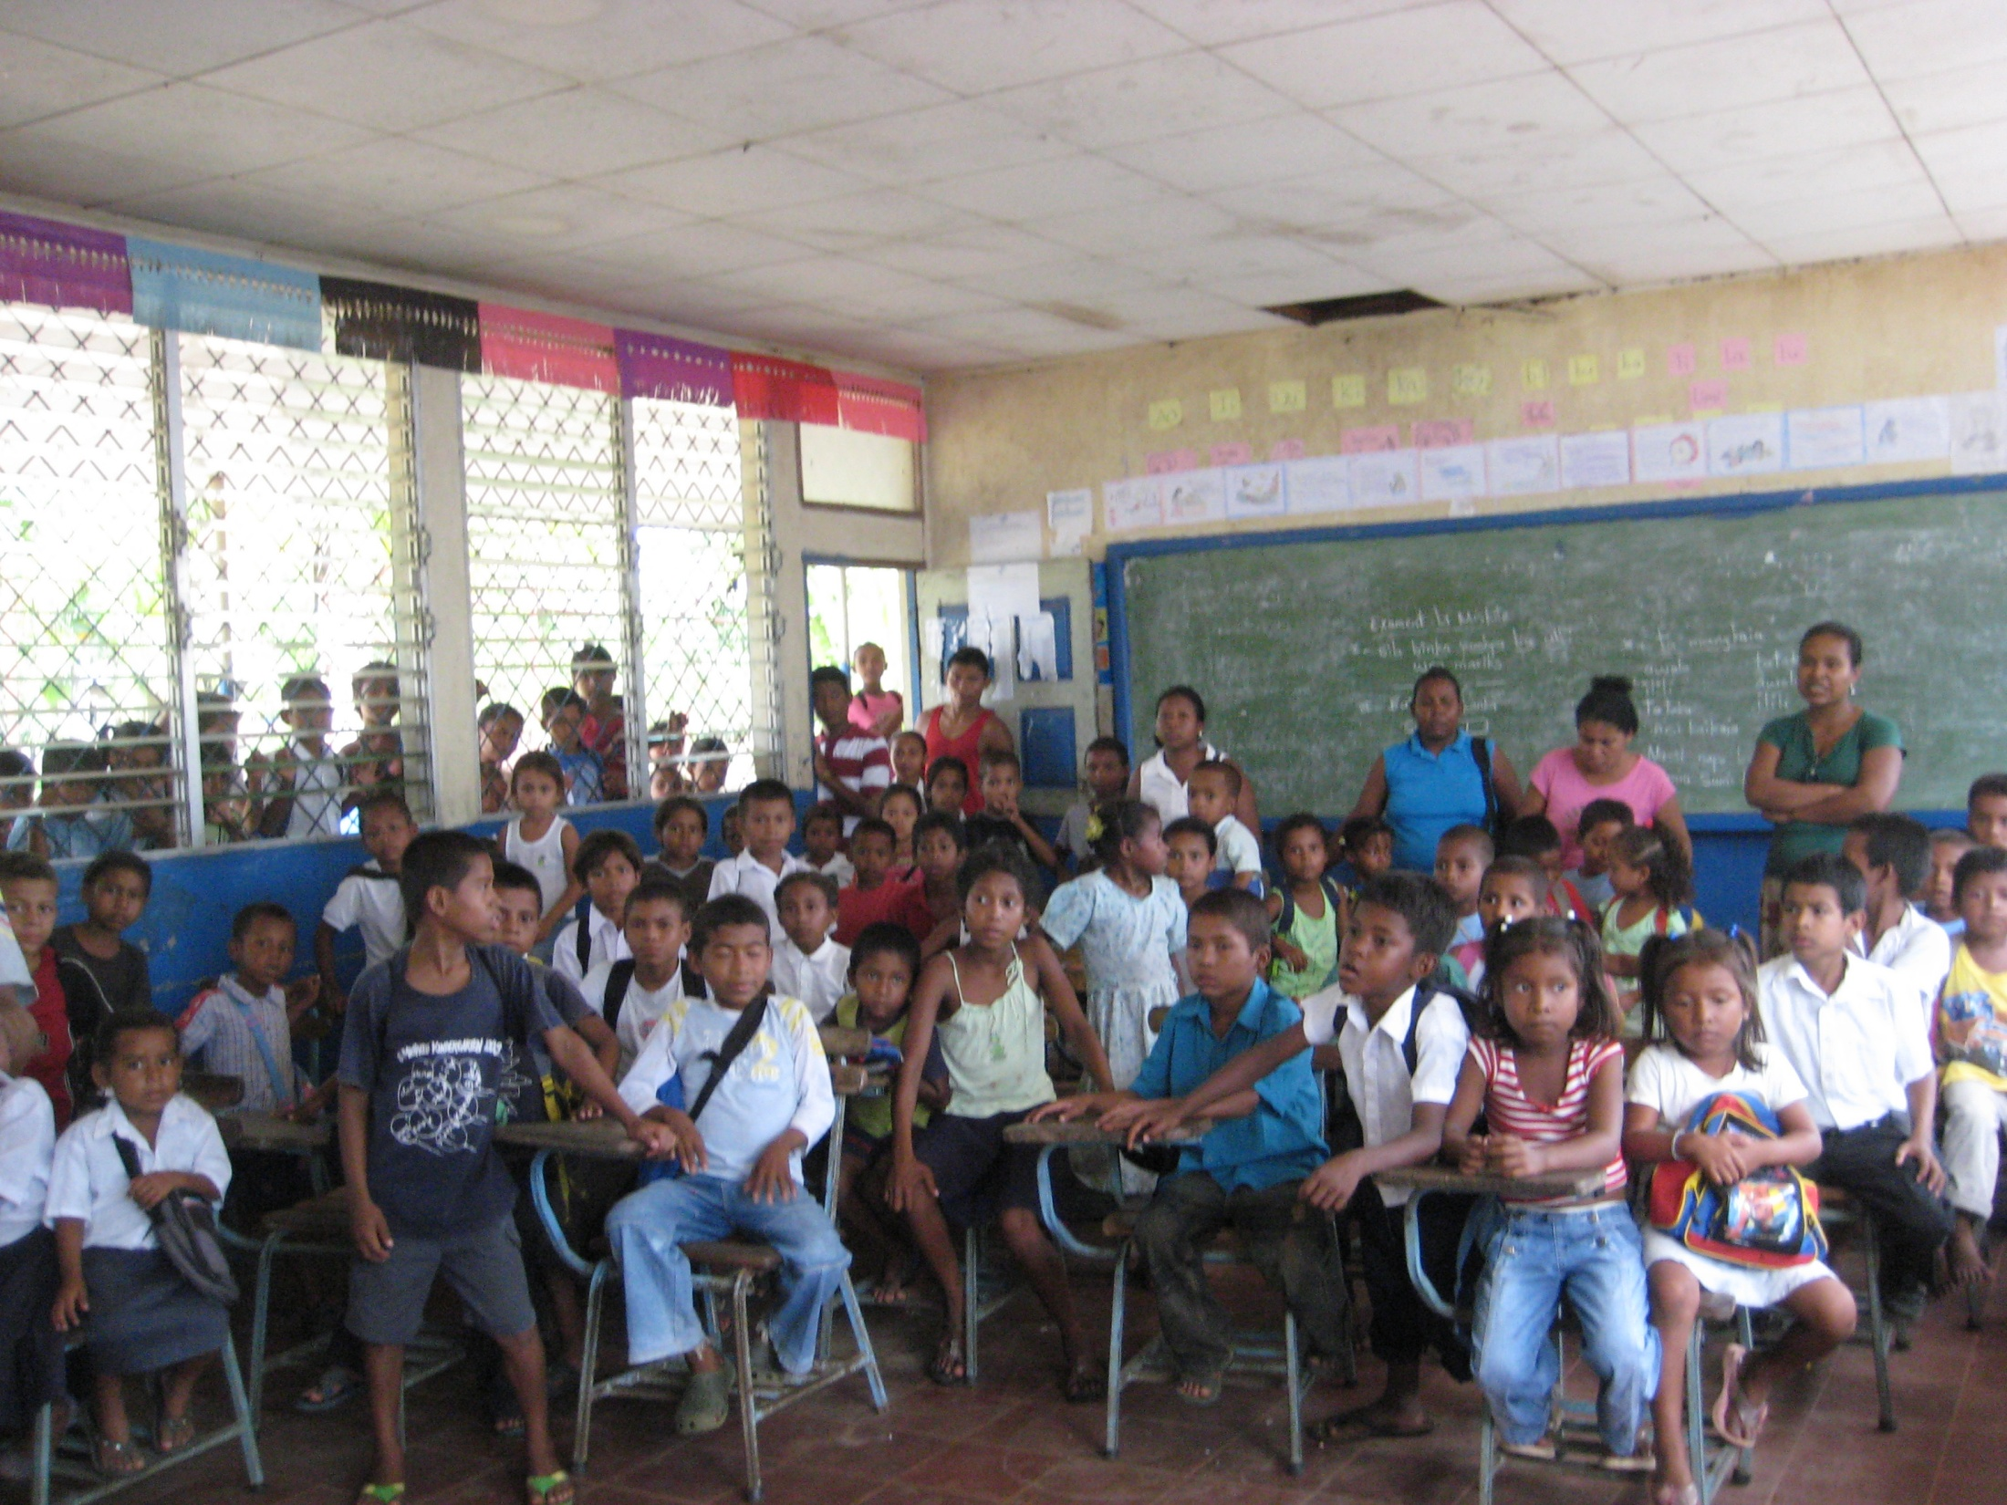
Everyone wants to learn how to care for their teeth!

Slide 34
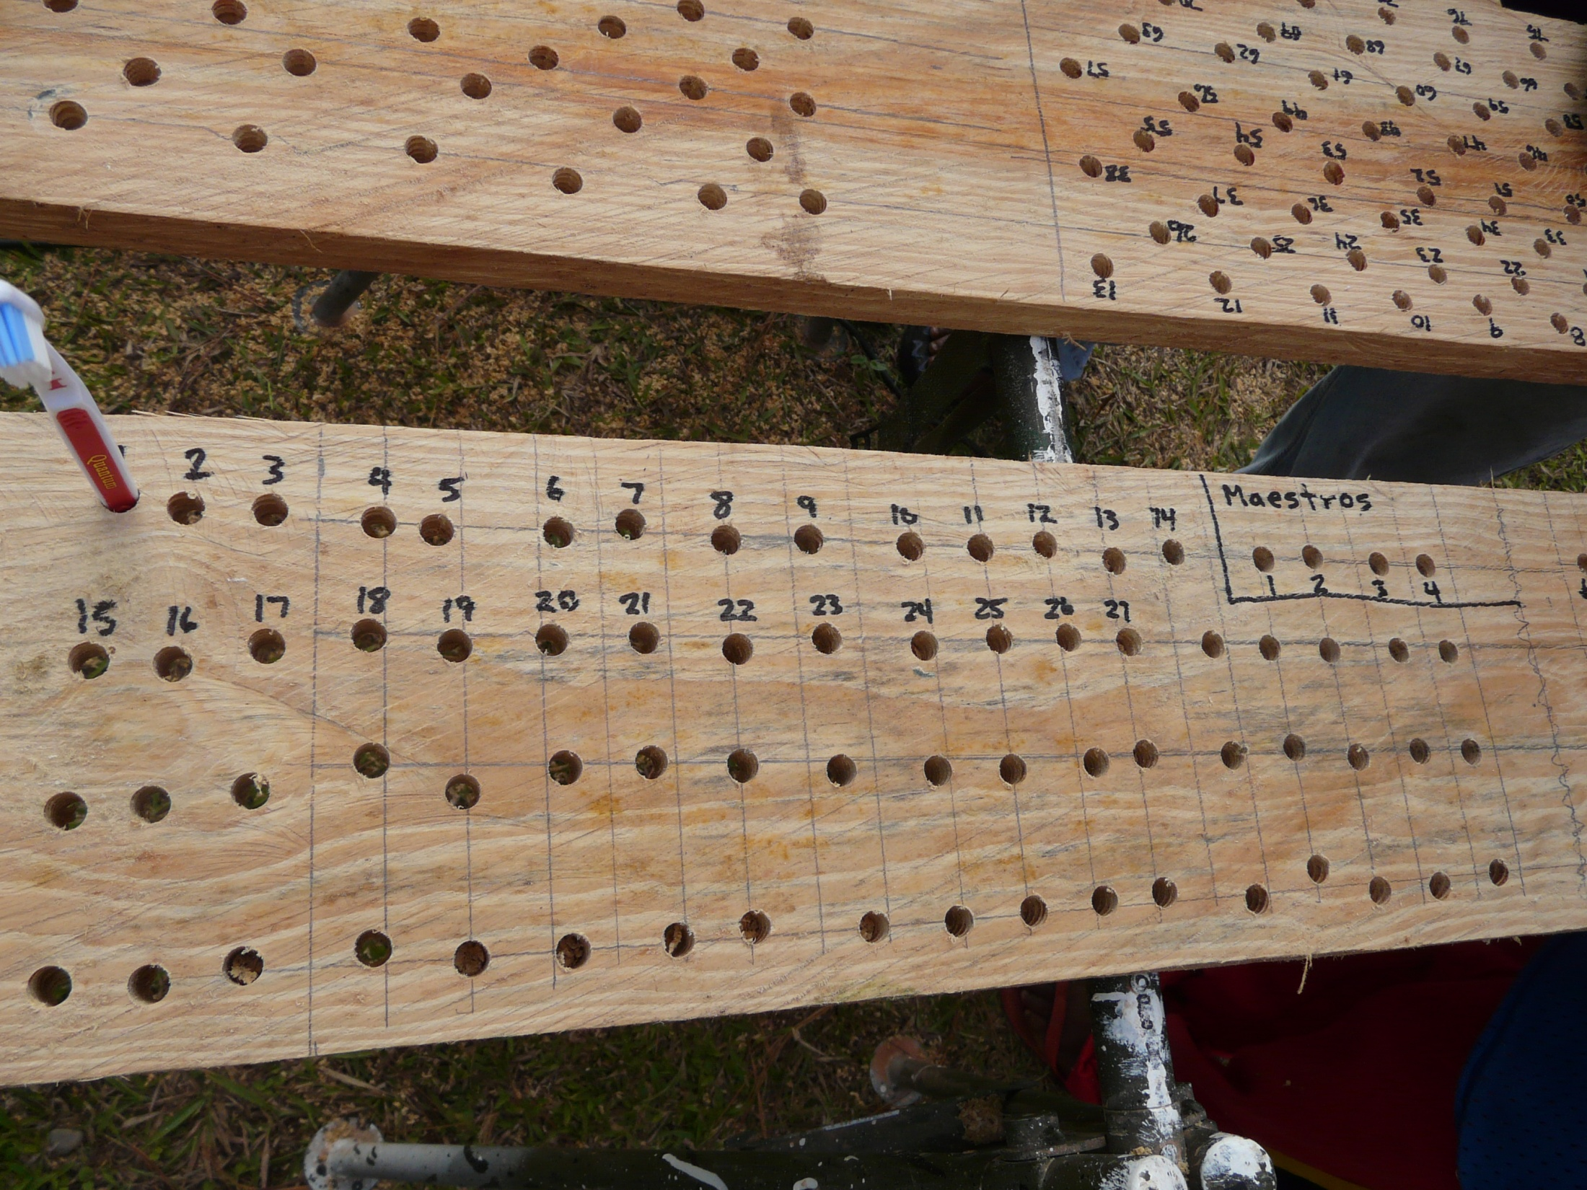
Our homemade classroom toothbrush rack.

Slide 35
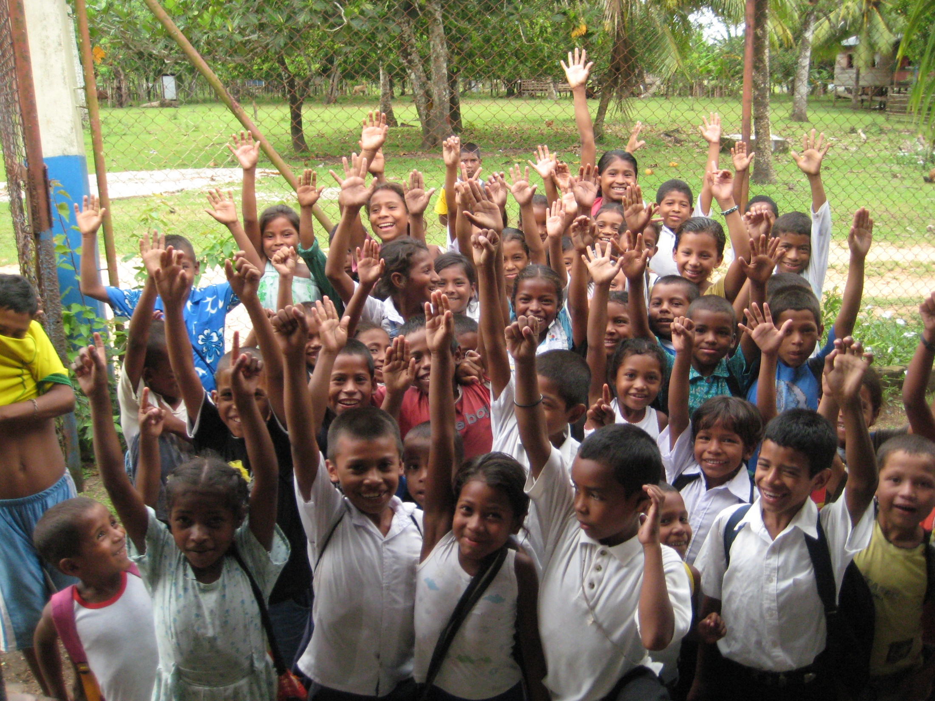
Who is going to brush their teeth?

Slide 36
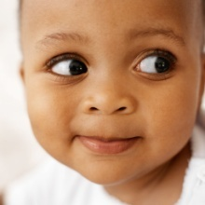
What do you know about keeping your teeth healthy?

Slide 37
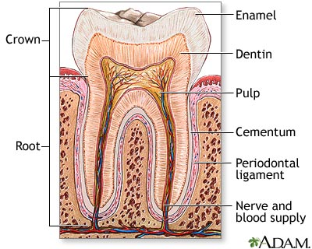
This is what a healthy tooth looks like.

Slide 38
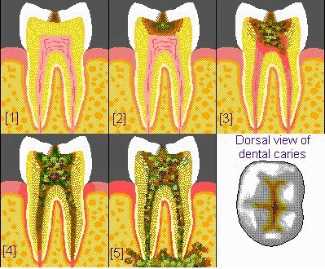
What is a cavity ?
OUCH

Slide 39
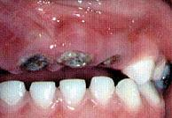
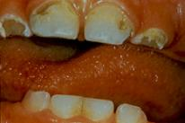
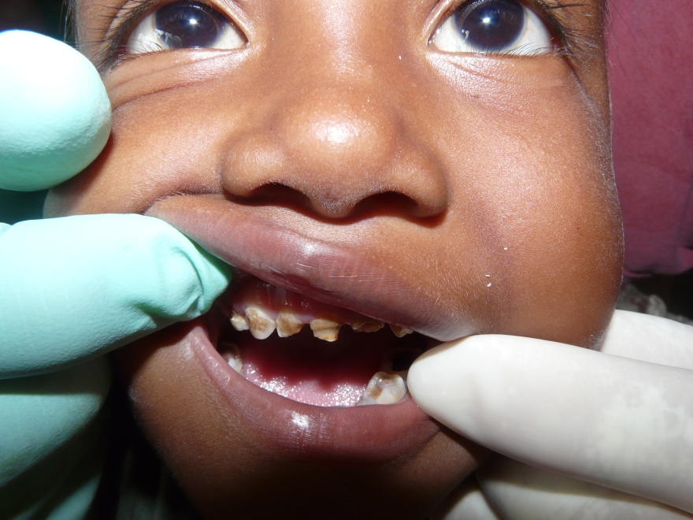
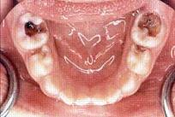
REALLY BAD CAVITIES !

Slide 40
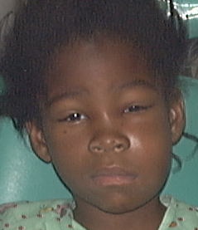
Why are cavities bad?
They hurt and can make you sick.
Notes:
If severe, a child may need surgery, hospitalization, or can die!
If sick, children miss school, and even if they can go, they can’t focus because their mouth HURTS so much.
Severe cavities cause speech and eating dysfunction.
If children don’t eat well, they don’t grow normally.
They cause infection and pain.

Slide 41
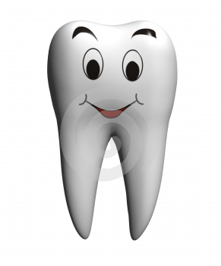
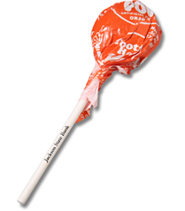
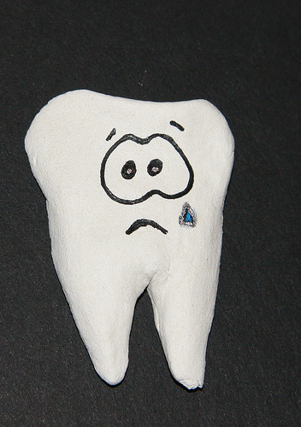
Sweets make your teeth sad!

Slide 42
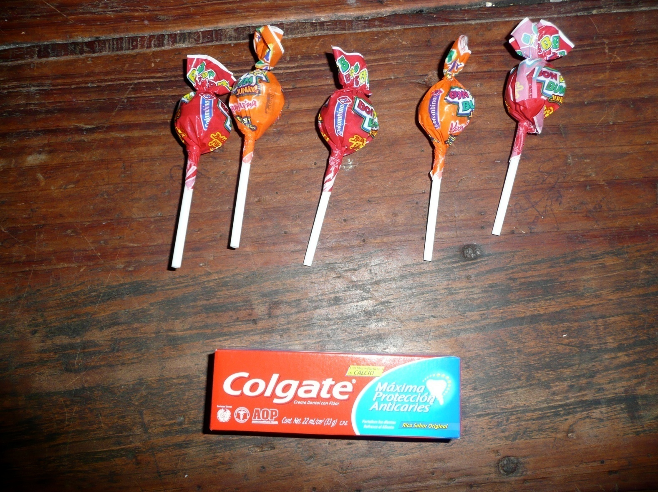
How much does it cost to have healthy teeth ?
5 Candies cost the same as 1 small tube of toothpaste.
What do you want your parents to buy?

Slide 43
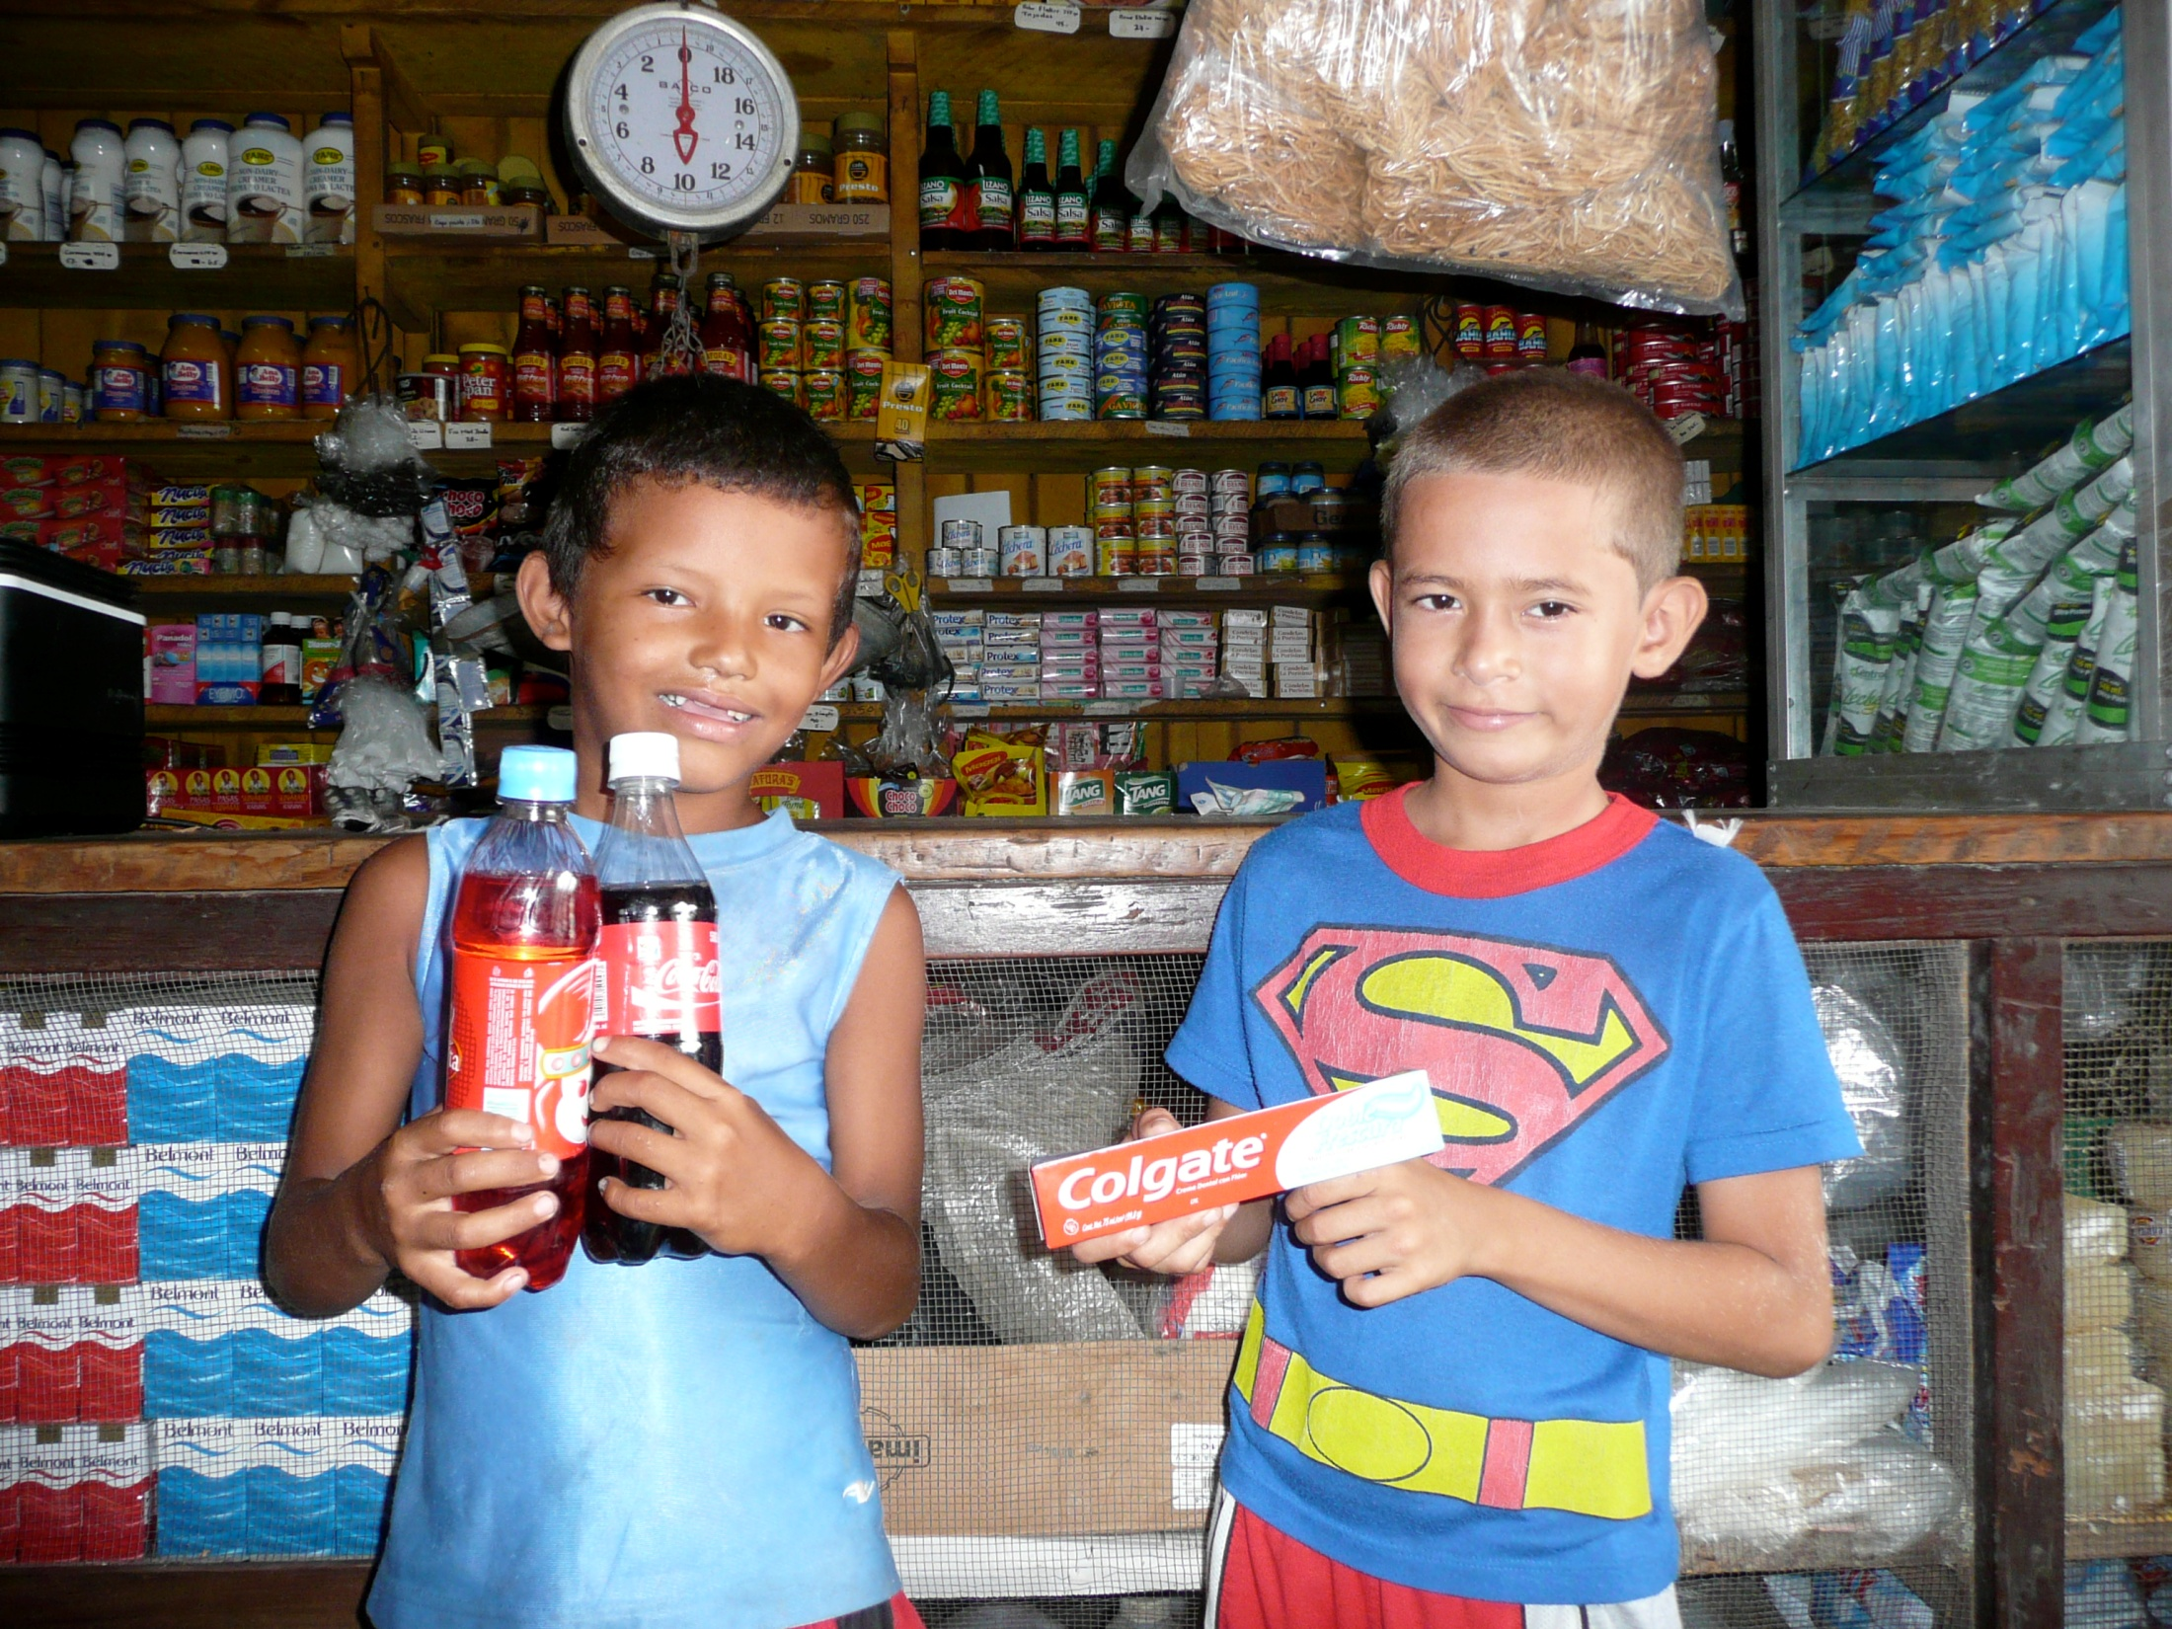
Which child will stay healthier? What do you choose?

Slide 44
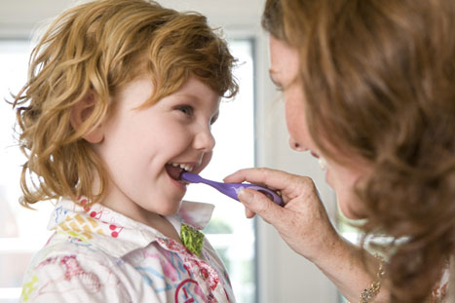
  Brush your teeth after you eat!
  Ask your parents to take you to the dentist twice/year
  Eat as few sweets, soda, and candy as possible!
  BRUSH, FLOSS, AND USE TOOTHPASTE

Slide 45
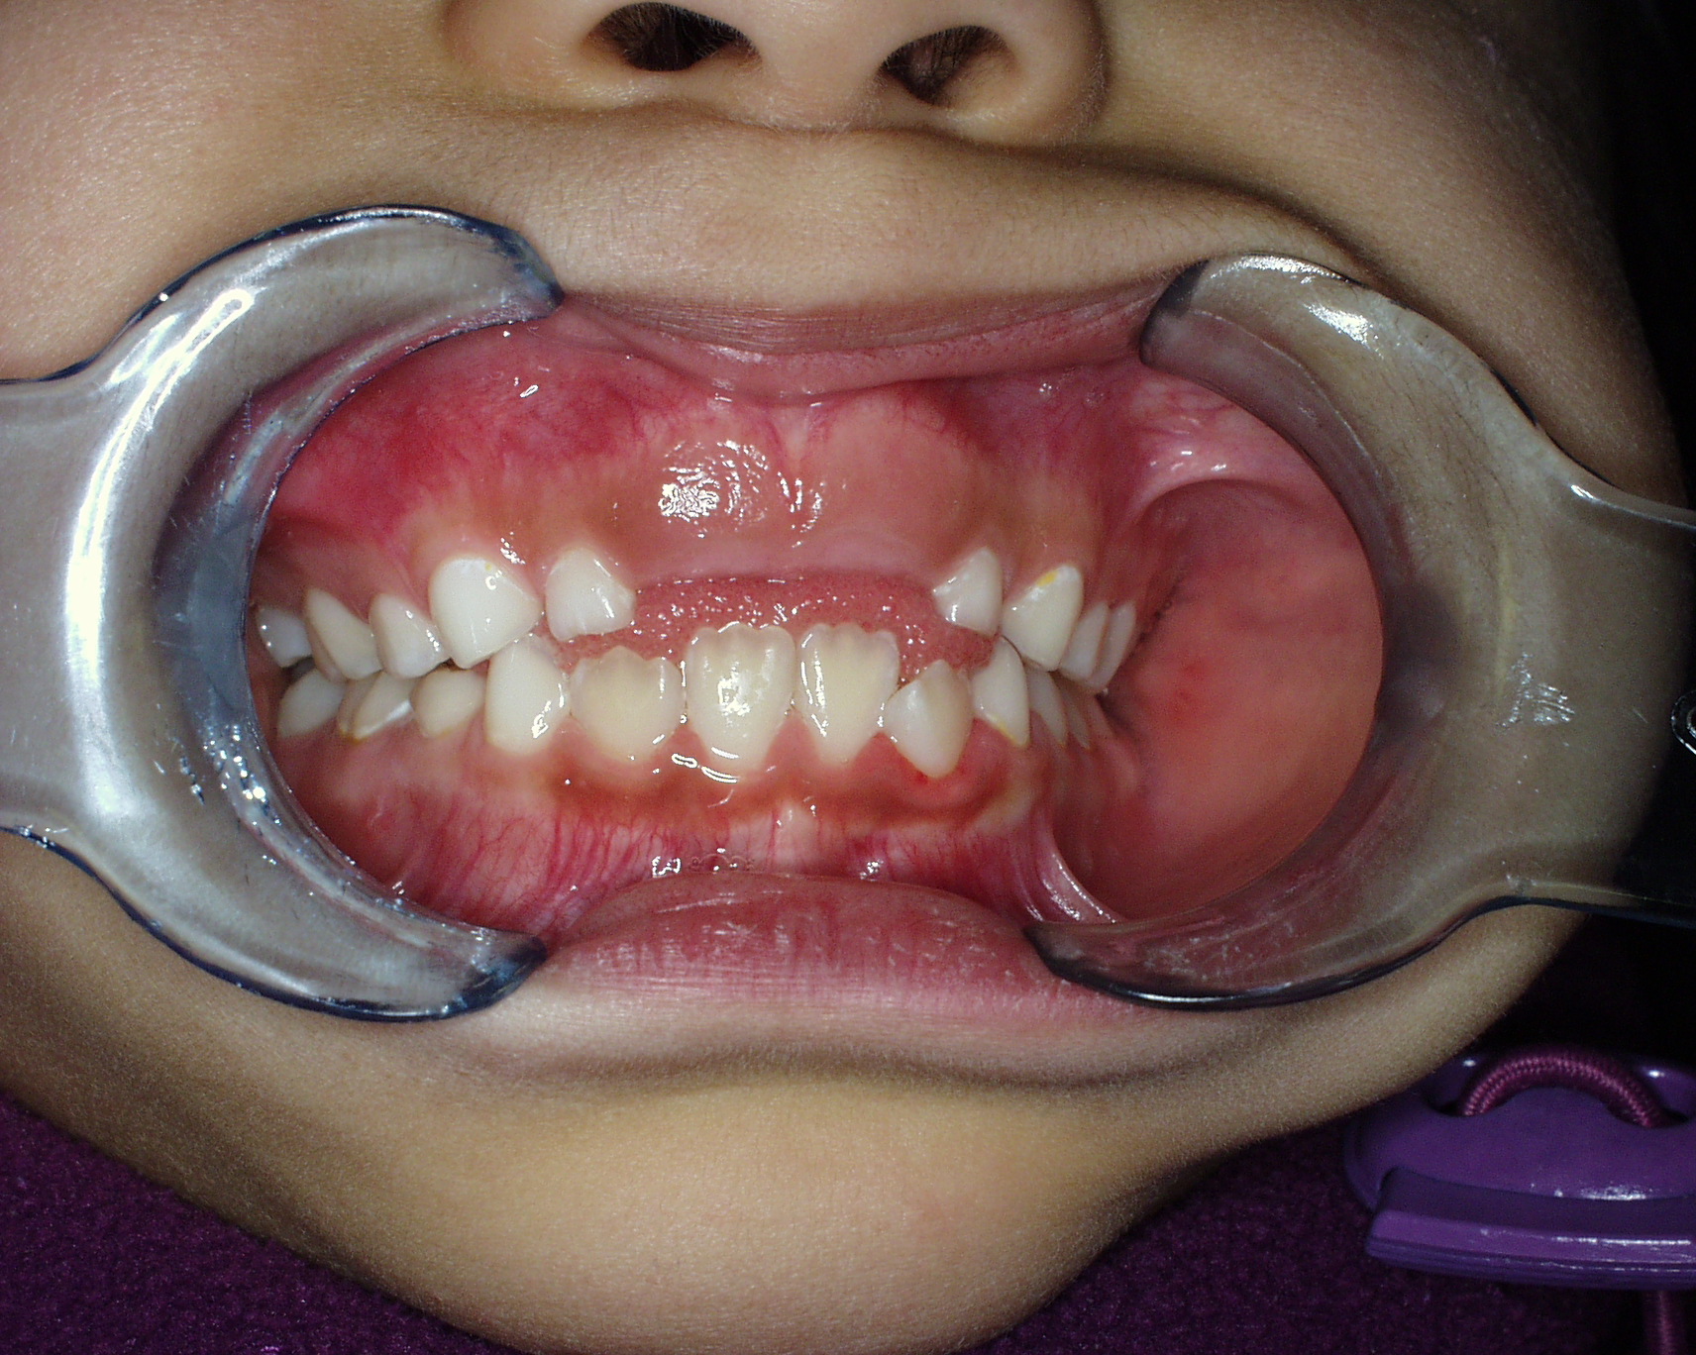
Fluoride Varnish
Makes your teeth stronger so you are less likely to get cavities.
The dentist paints it on your teeth, and there is fluoride in toothpaste.
Fluoride is GOOD!

Slide 46
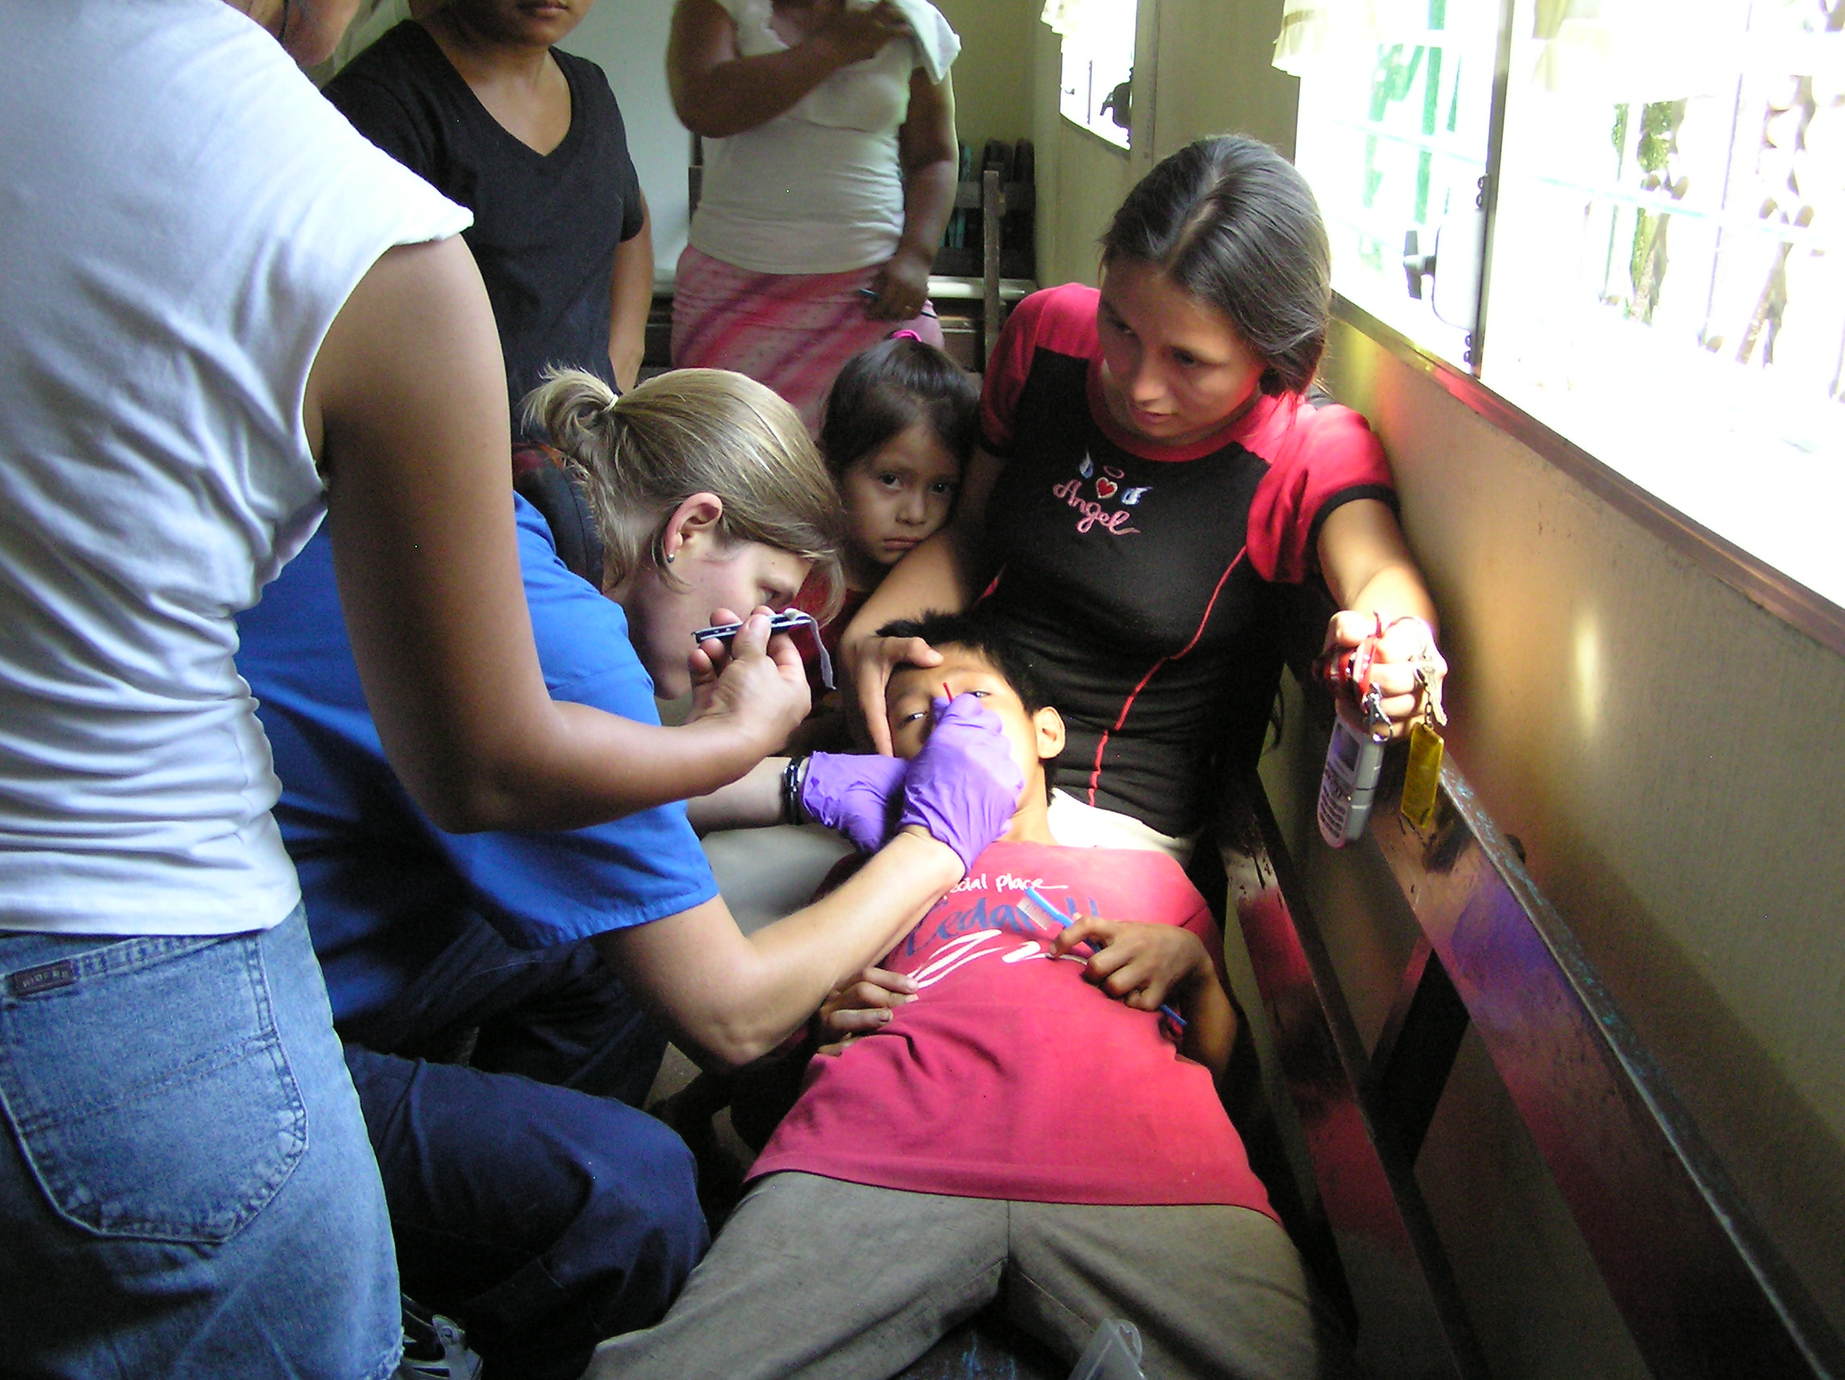
Demonstrating how to apply fluoride varnish.

Slide 47

To get a smile like this….
BRUSH ! ! !
Go to the dentist.
Use fluoride toothpaste.

Slide 48

These were the first crayons and coloring books the kids had ever seen.

Slide 49
Save Their Smiles First Annual Toothbrush Drive
How can you help?
Give a toothbrush or two. Little brushes are best.
Donate 1 dollar or two to buy fluoride for a child.
Ask your dentist if he or she can donate.
We can do it with your help.
You can make a difference!

Slide 50

We can Save Their Smiles !

Slide 51

www.SavetheirSmiles.org

